Slide 1
BCCA figures
March 13 2025

Slide 2
Data % to report
X2.1.Flow.Type n prop
<chr> <int> <dbl>
1 Biotic 113 0.551
2 Human movement 21 0.102
3 Physical 38 0.185
4 Sociocultural 33 0.161

Slide 3
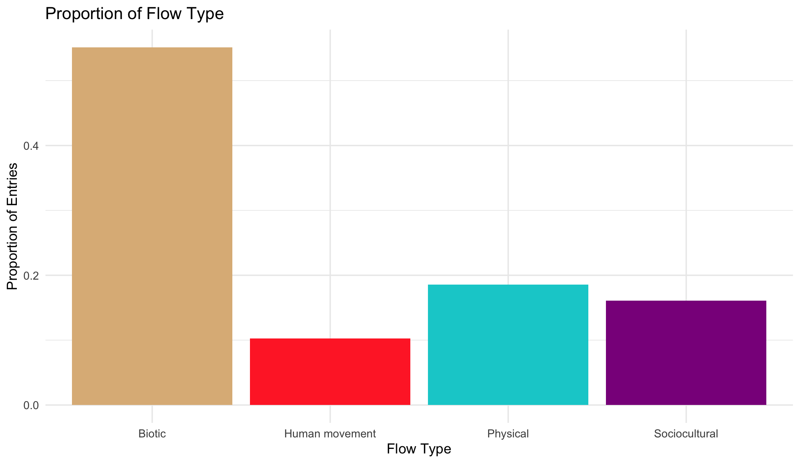

Slide 4
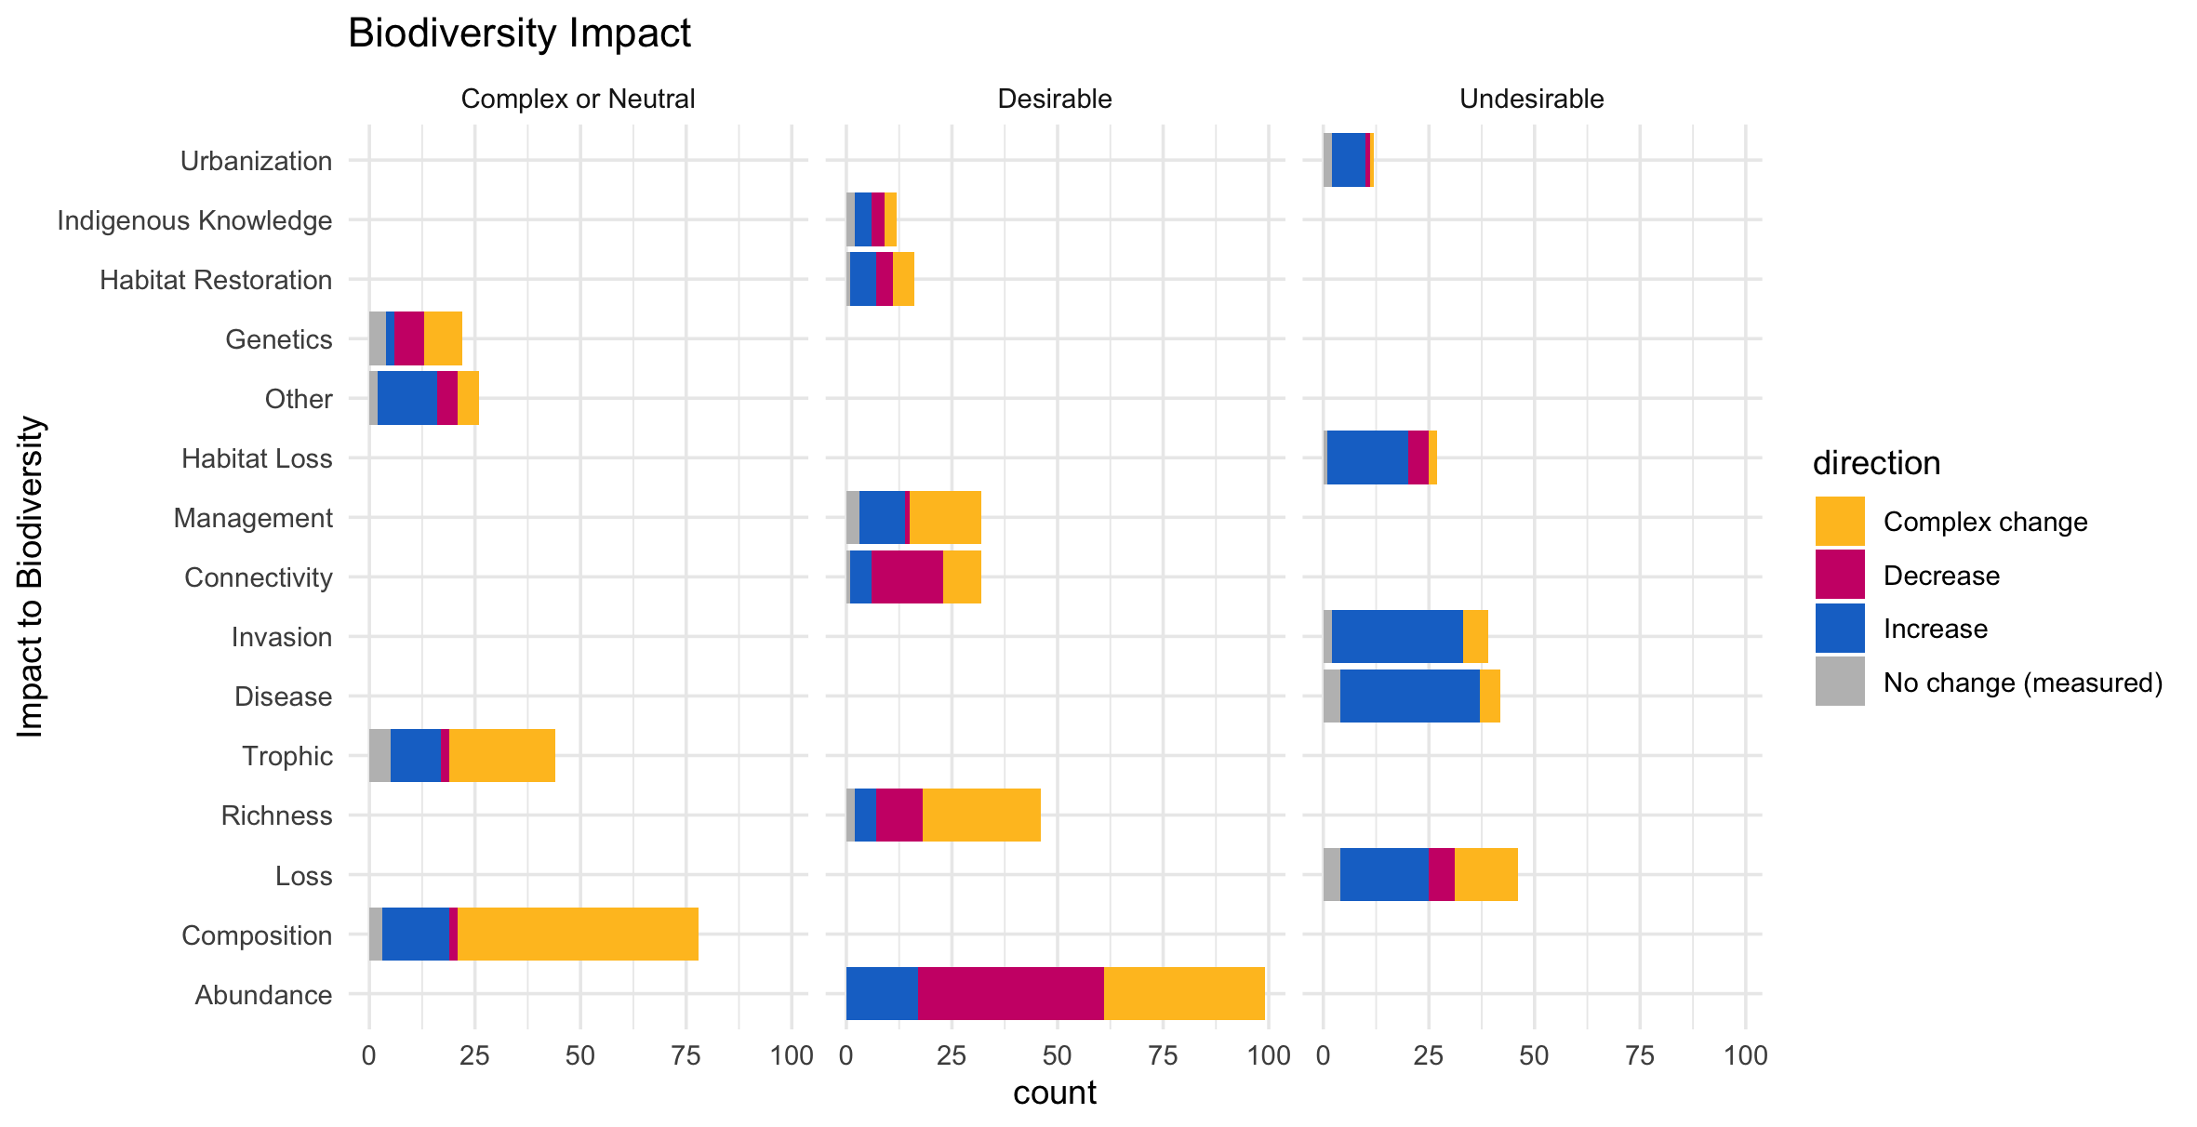

Slide 5
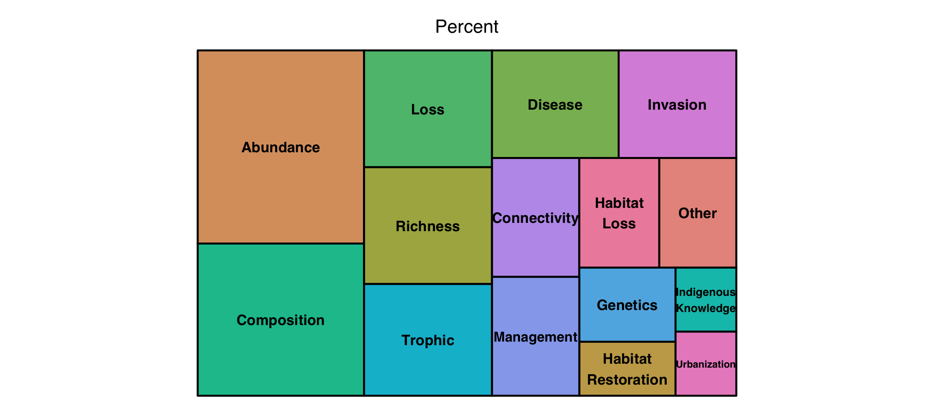

Slide 6
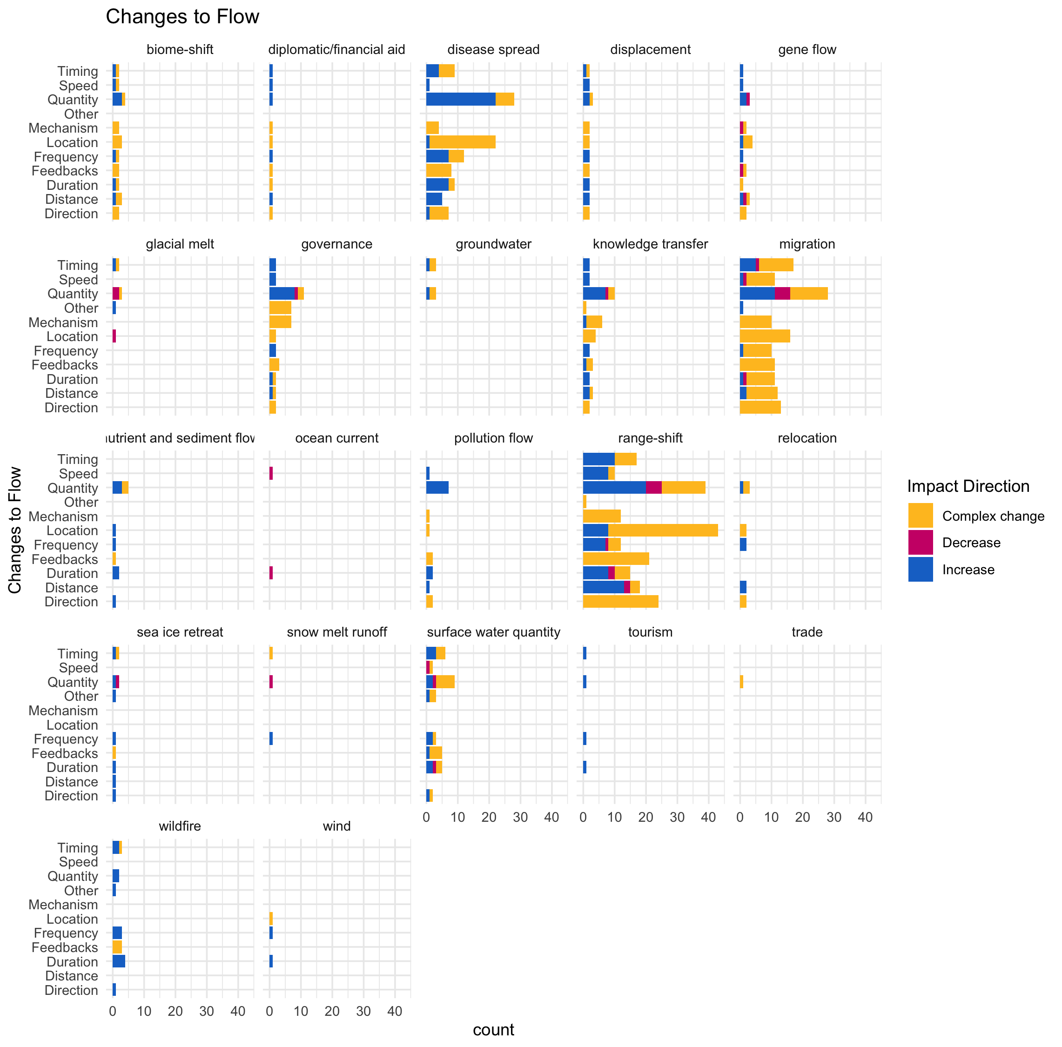

Slide 7
Multiple flows
Another.Flow. n prop
1 No 168 0.820
2 Yes 37 0.180

Slide 8
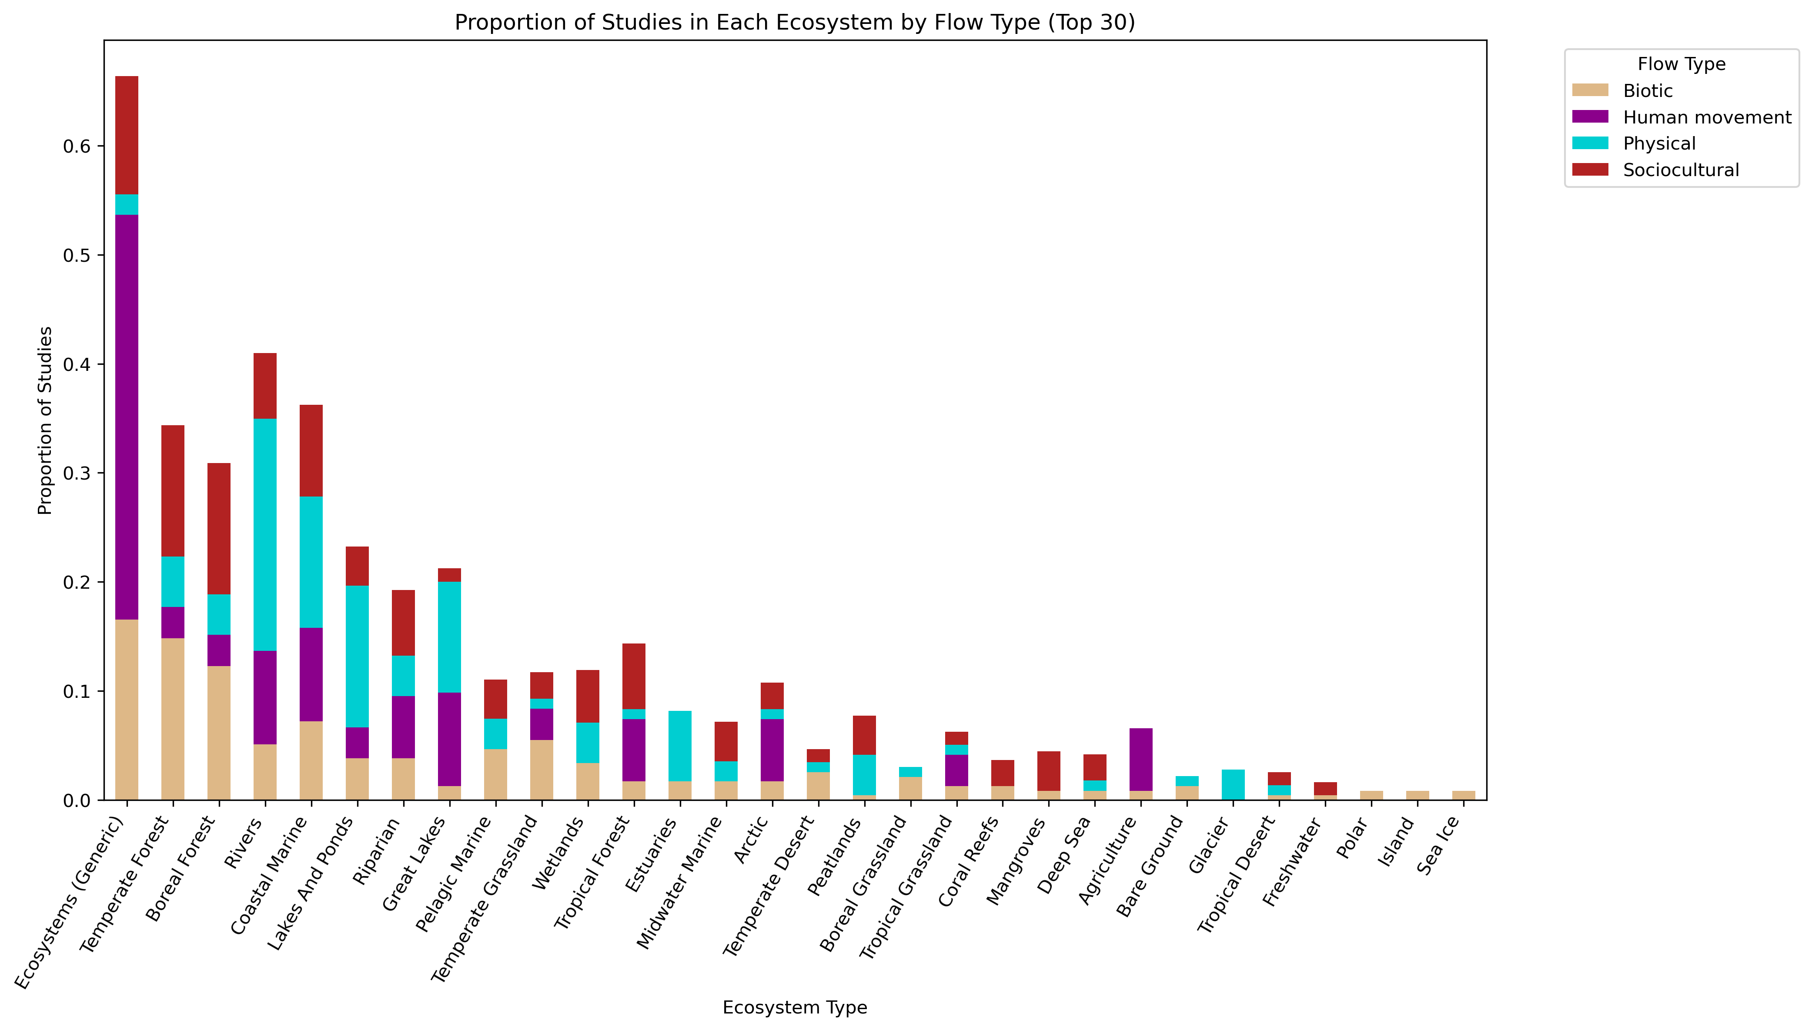
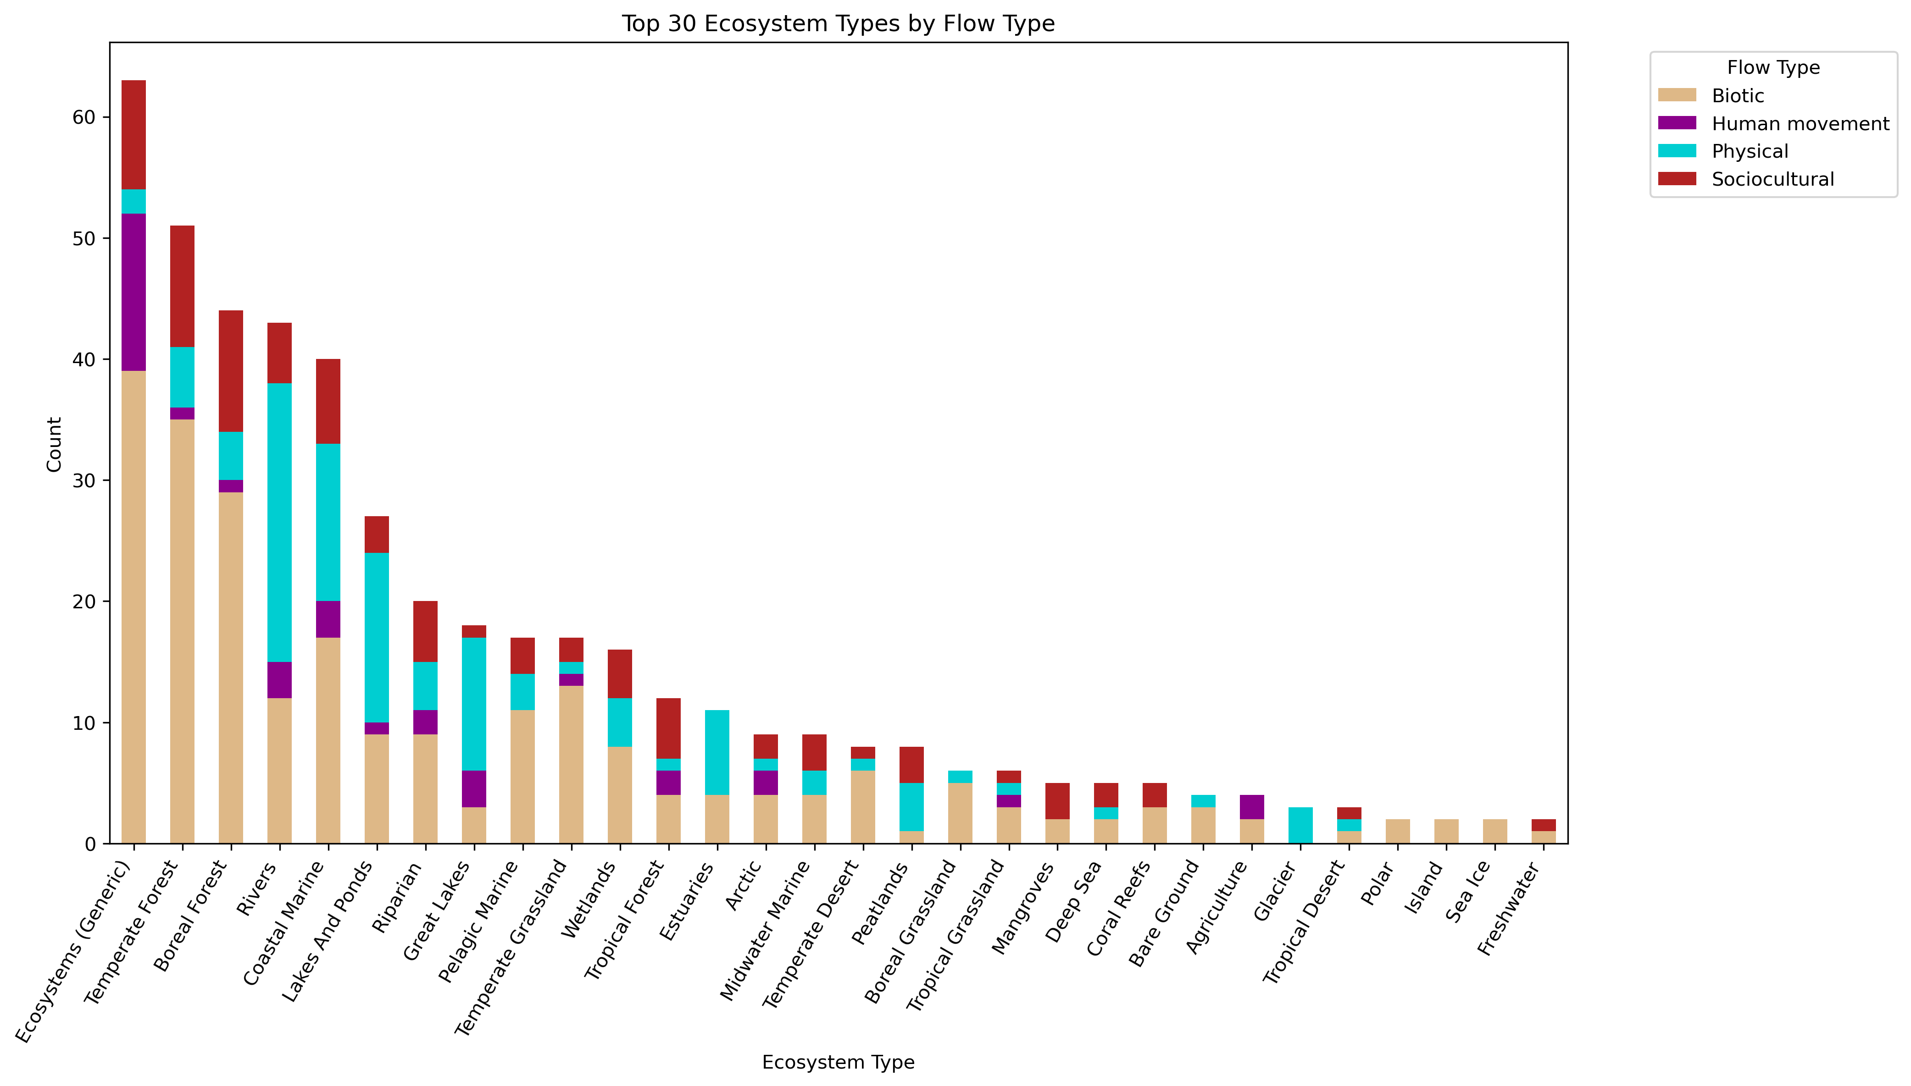

Slide 9
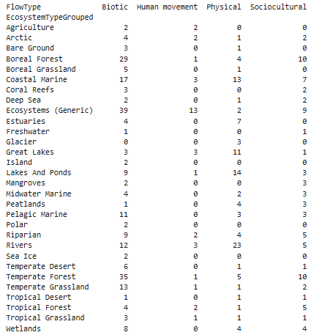
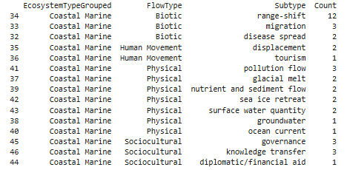

Slide 11
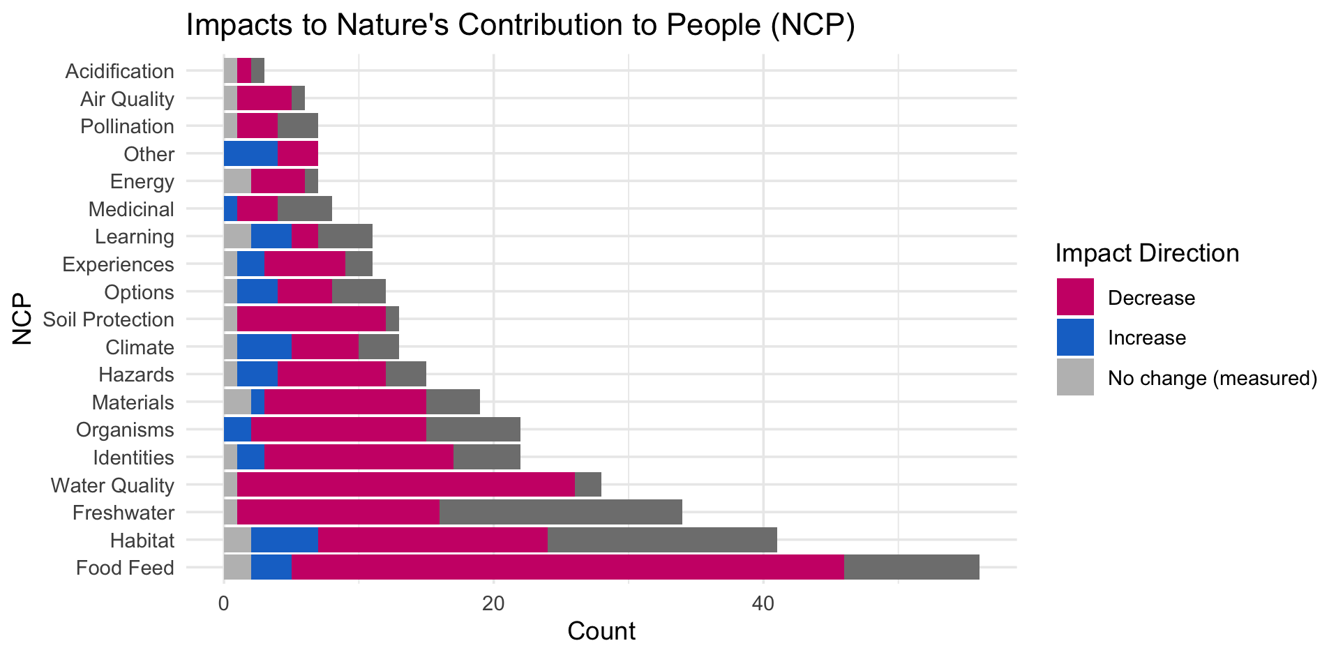

Slide 13
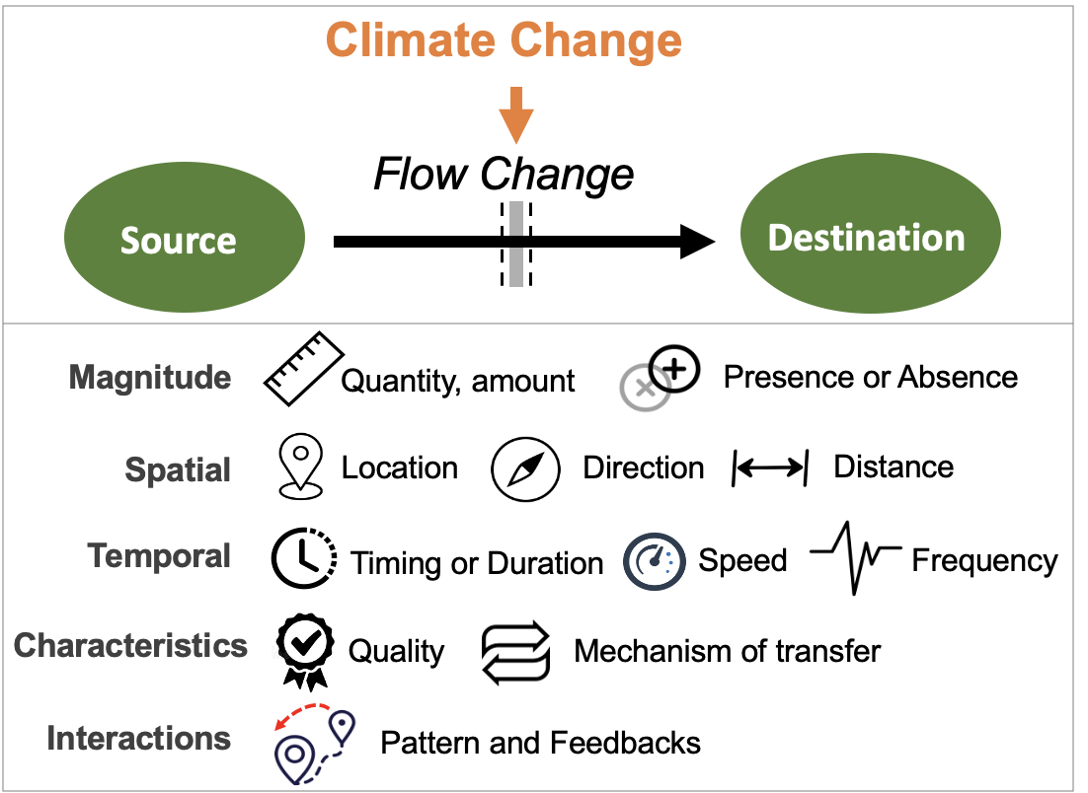
Most common paths
Climate change →

Slide 14
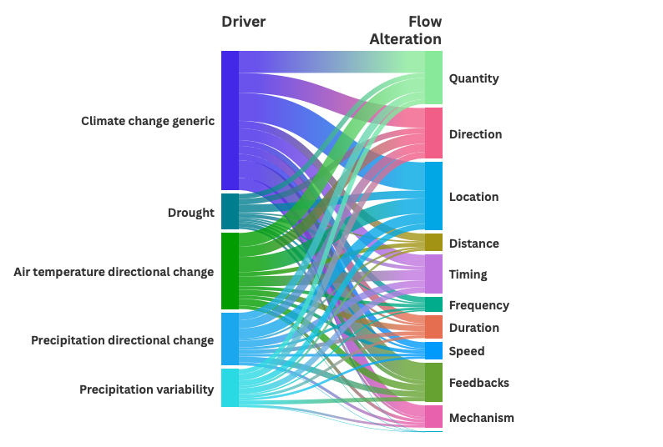

Slide 15
HWB studies count
# Cohesion Justice Other Relational Welfare
# 18 21 7 31 76

Slide 16
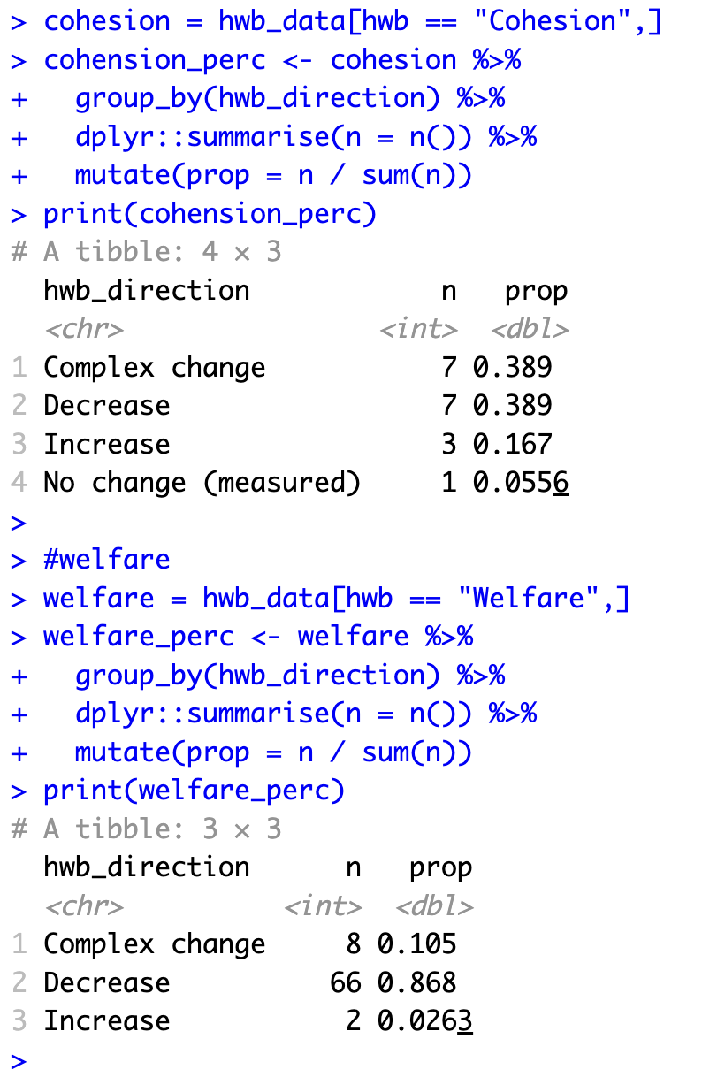
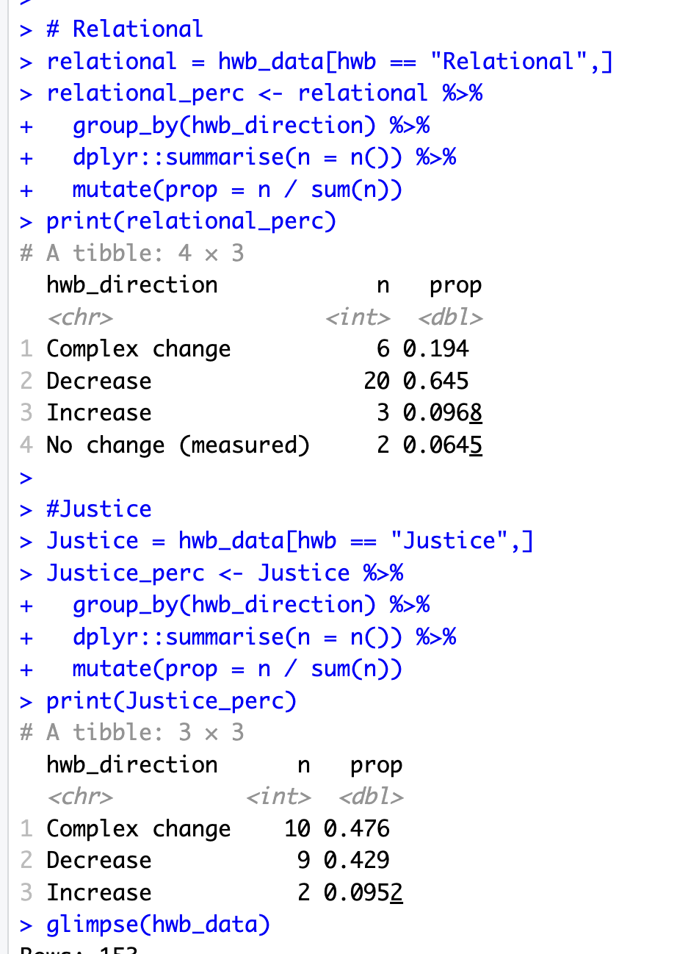

Slide 17
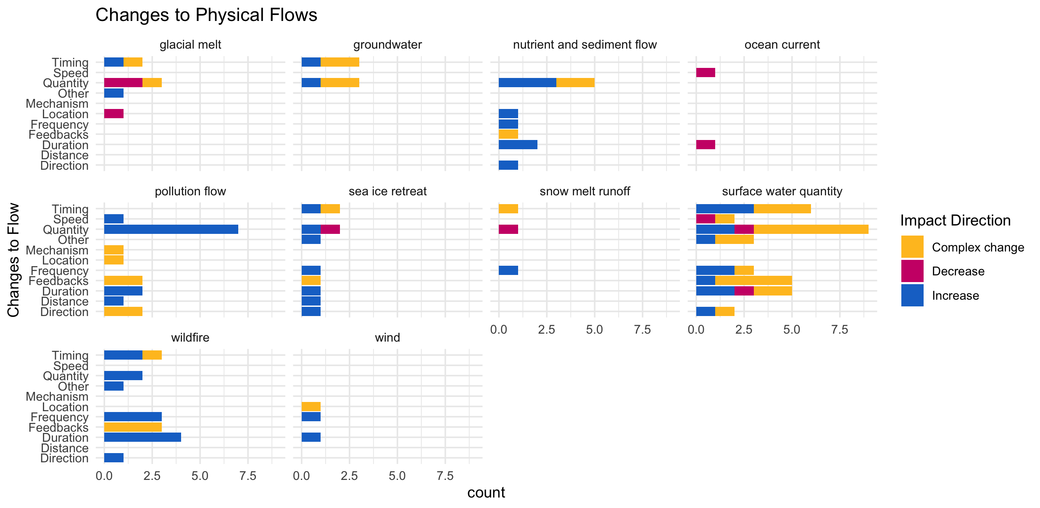

Slide 18
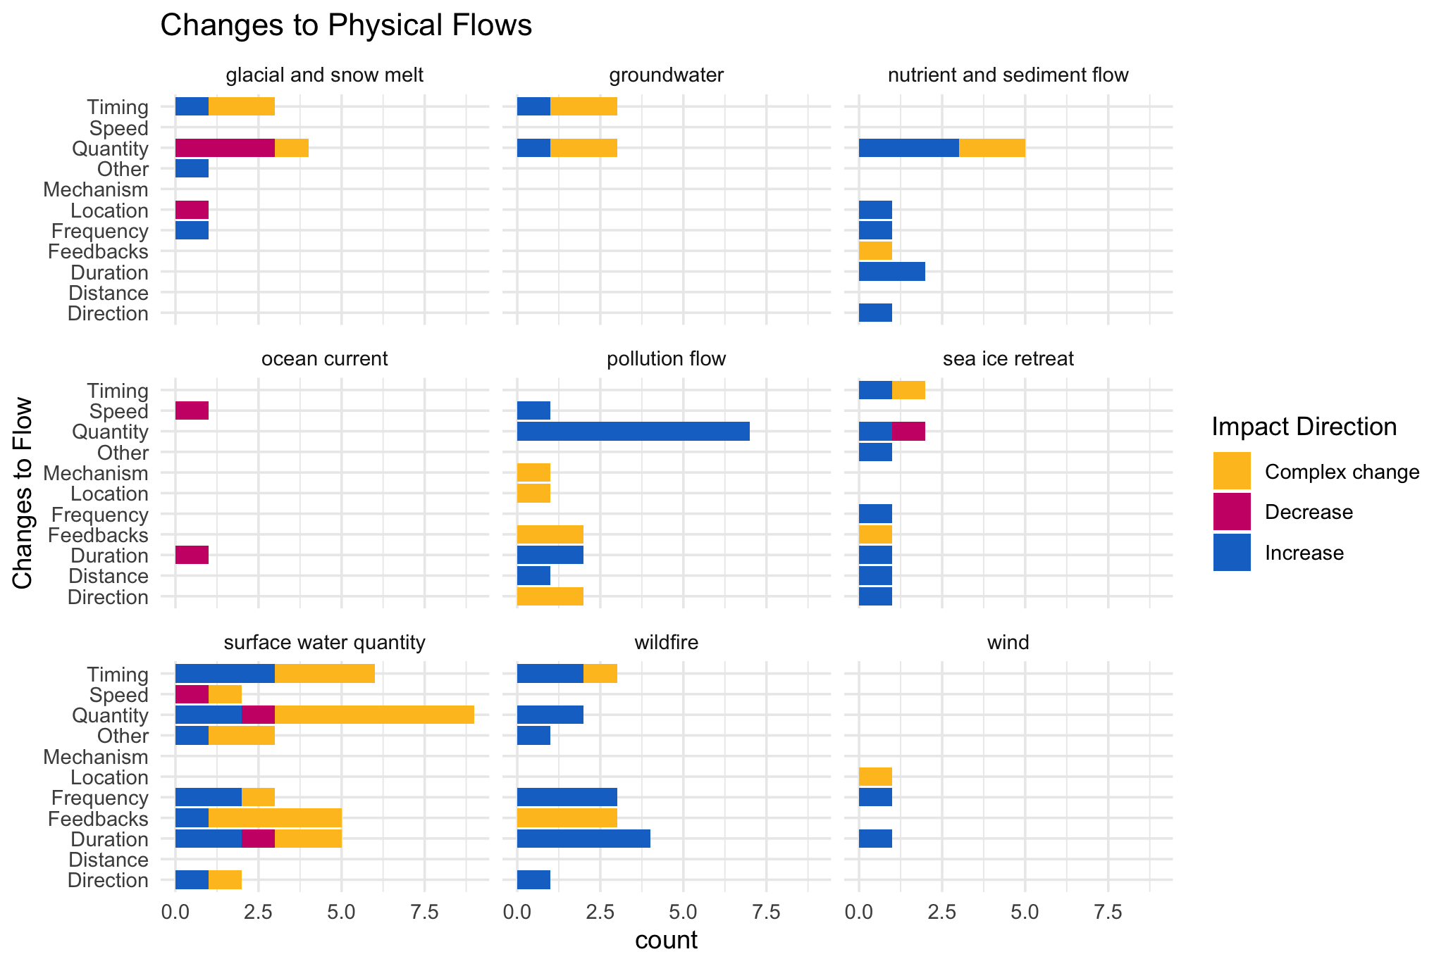

Slide 19
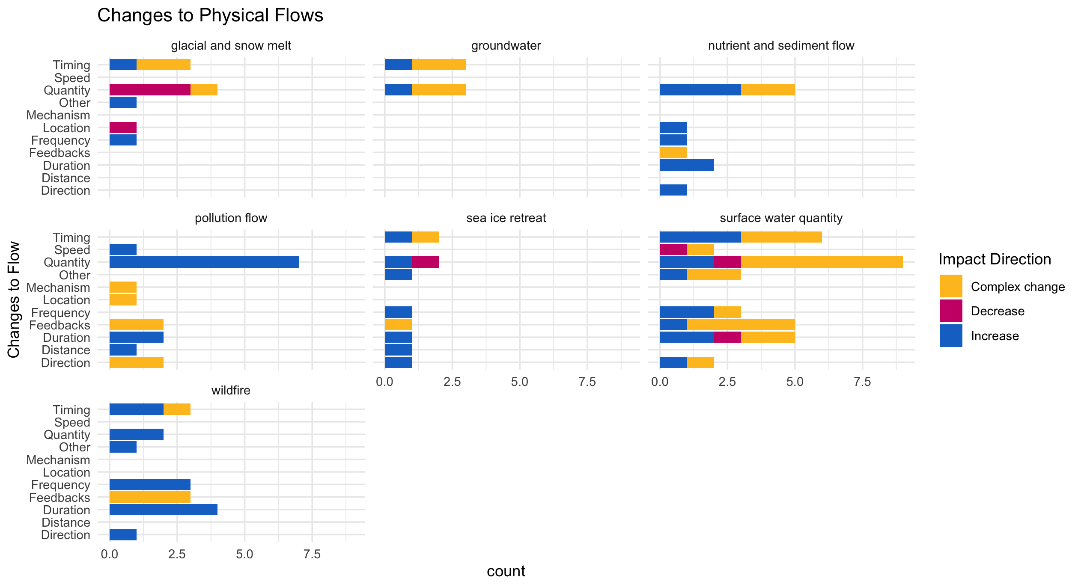

Slide 20
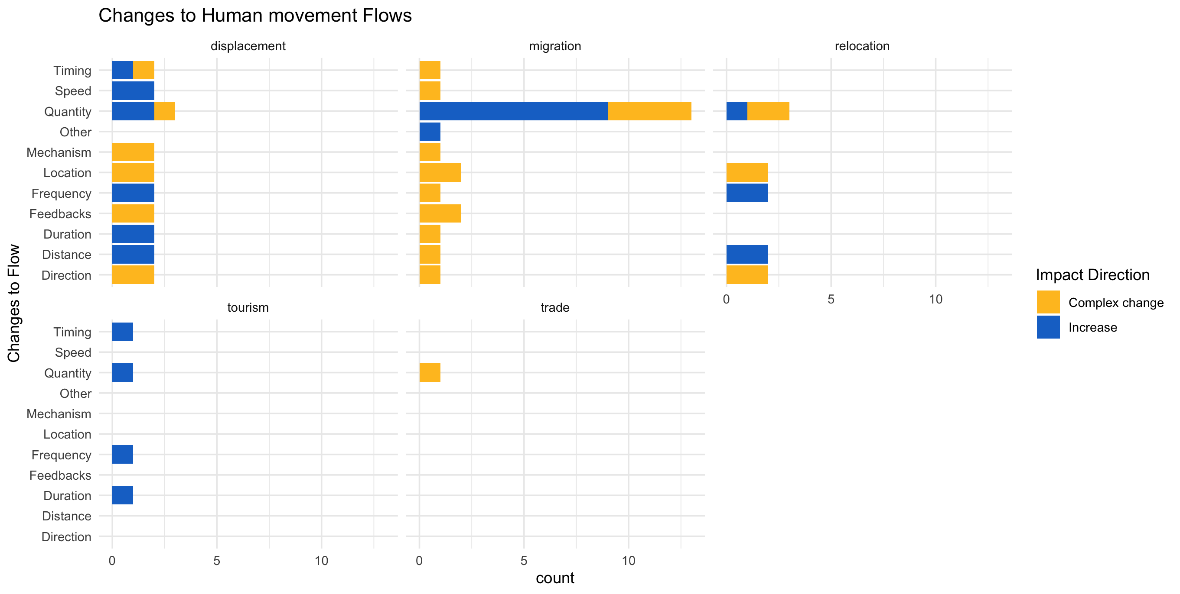

Slide 21
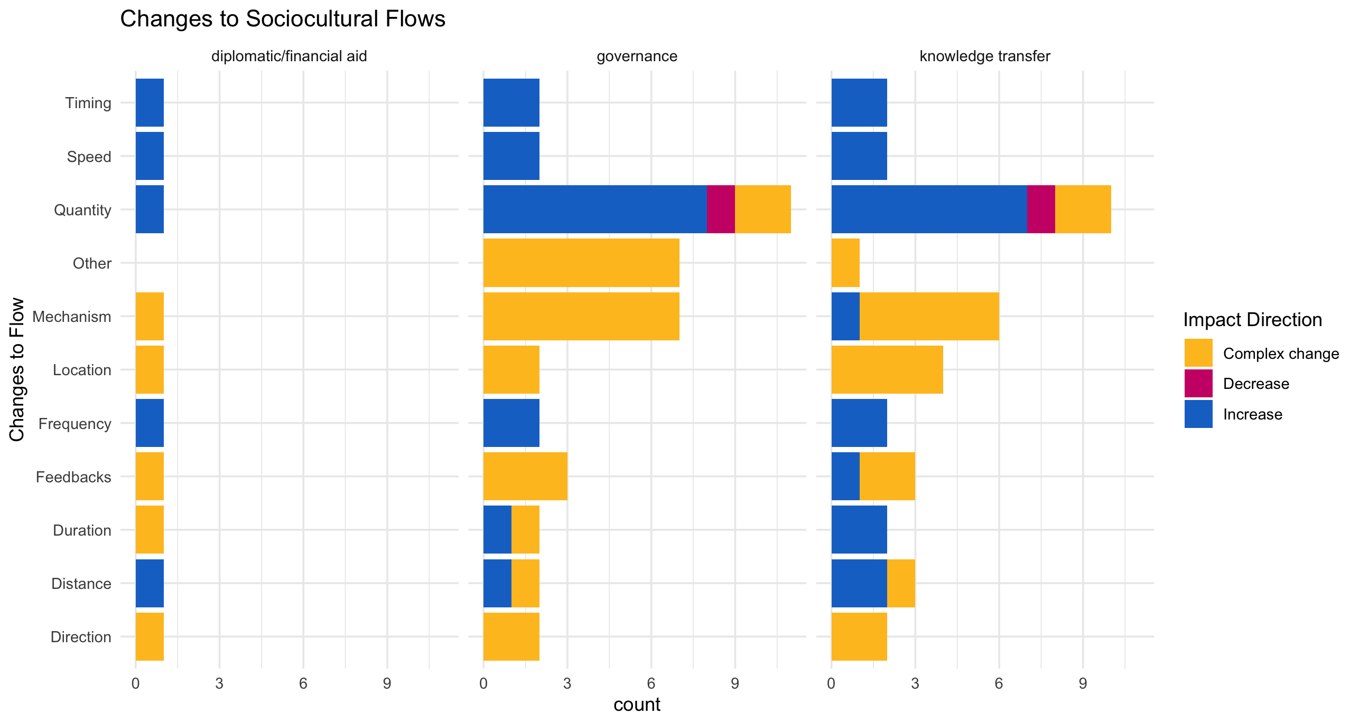

Slide 22
hwb_direction n prop
<chr> <int> <dbl>
1 Complex change 8 0.105
2 Decrease 66 0.868
3 Increase 2 0.0263

Slide 23
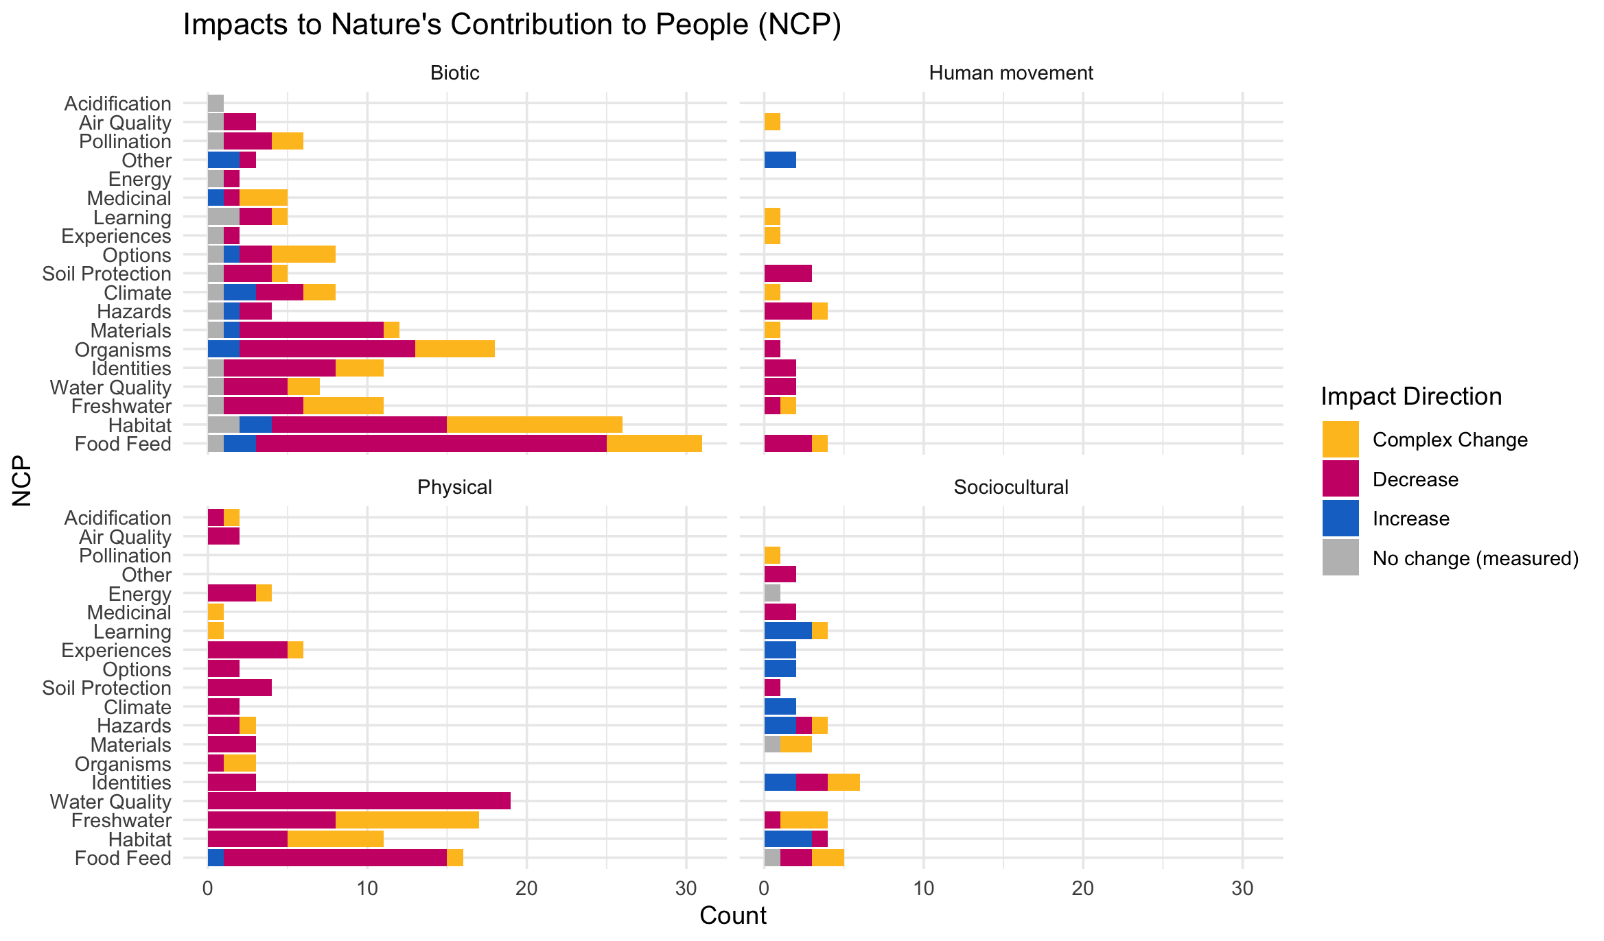

Slide 24
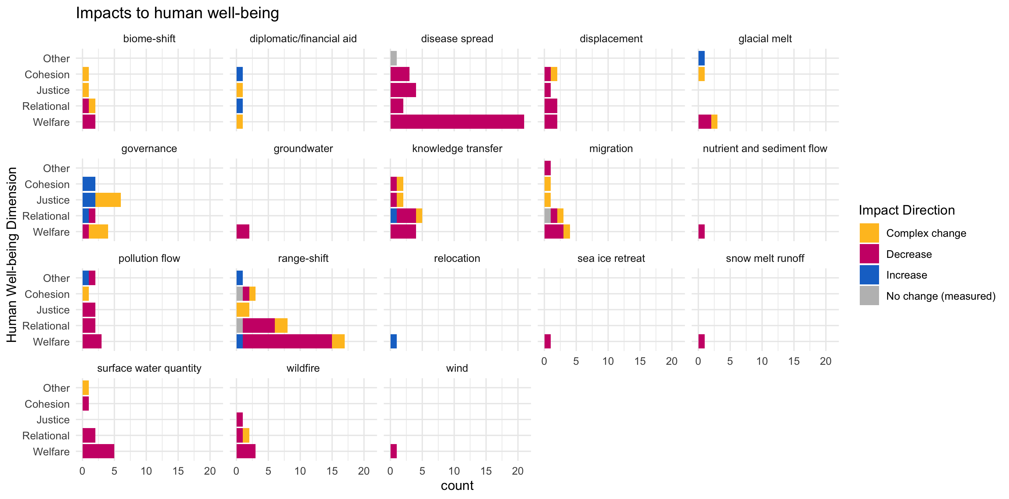

Slide 25
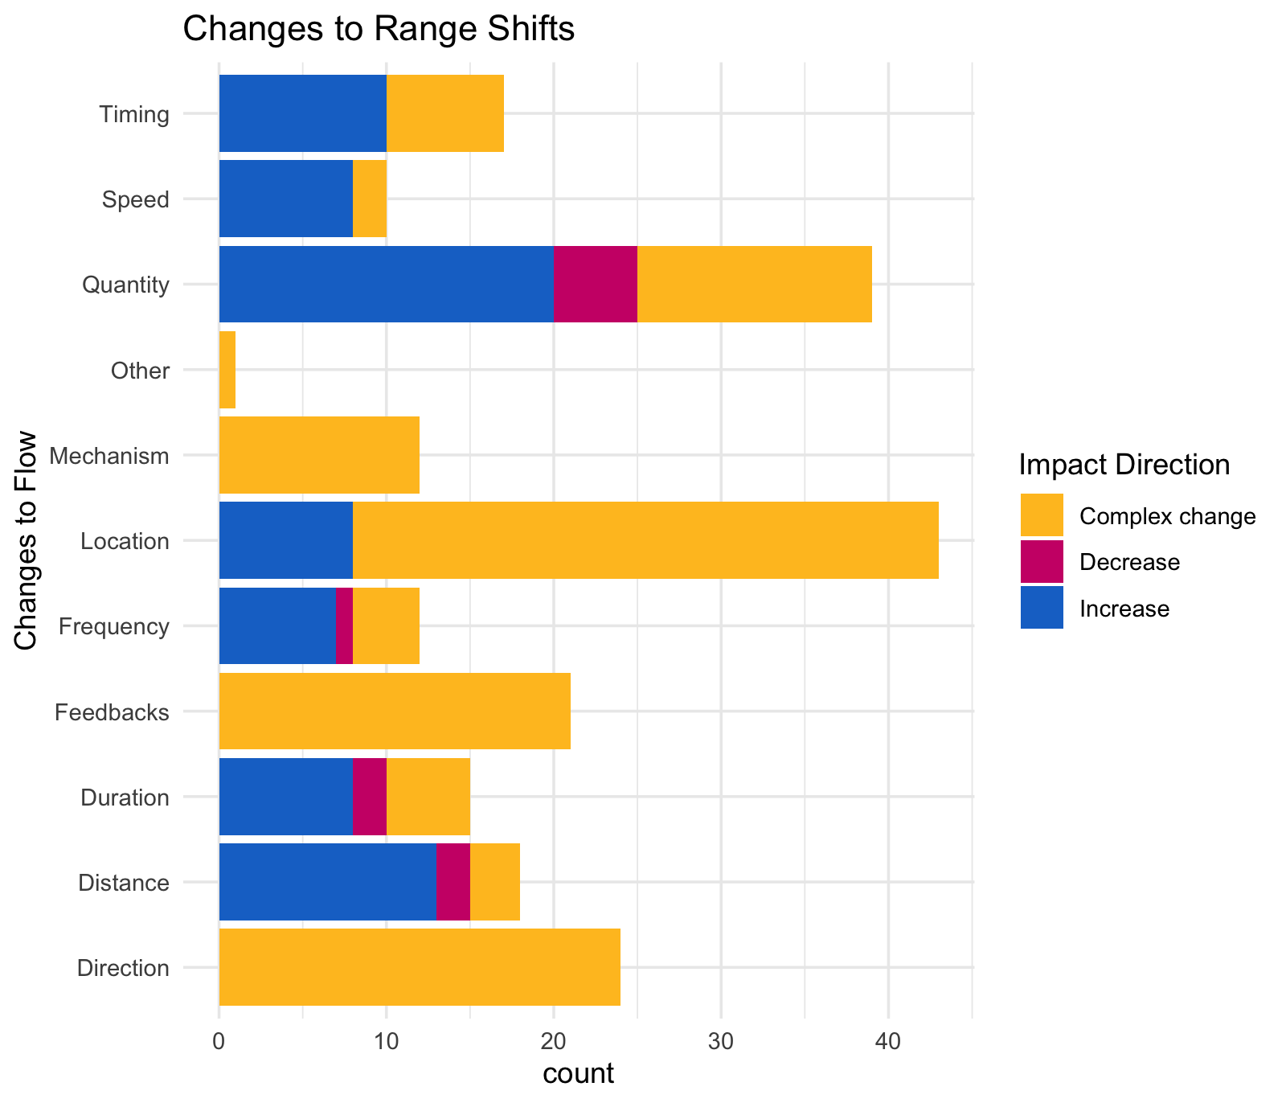

Slide 26
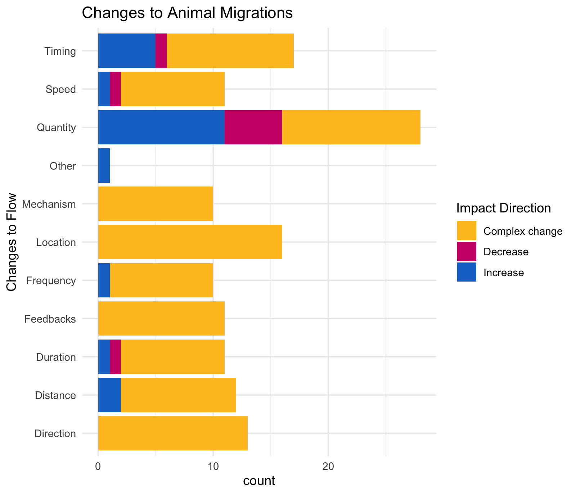

Slide 27
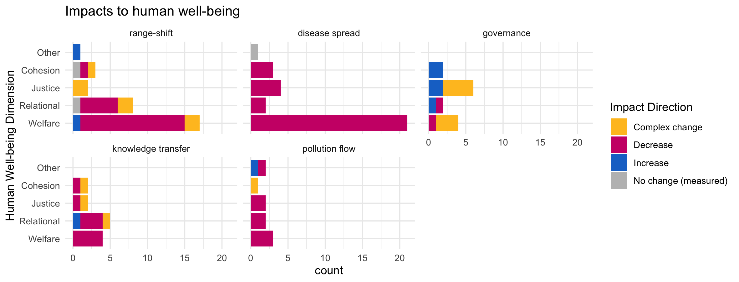

Slide 28
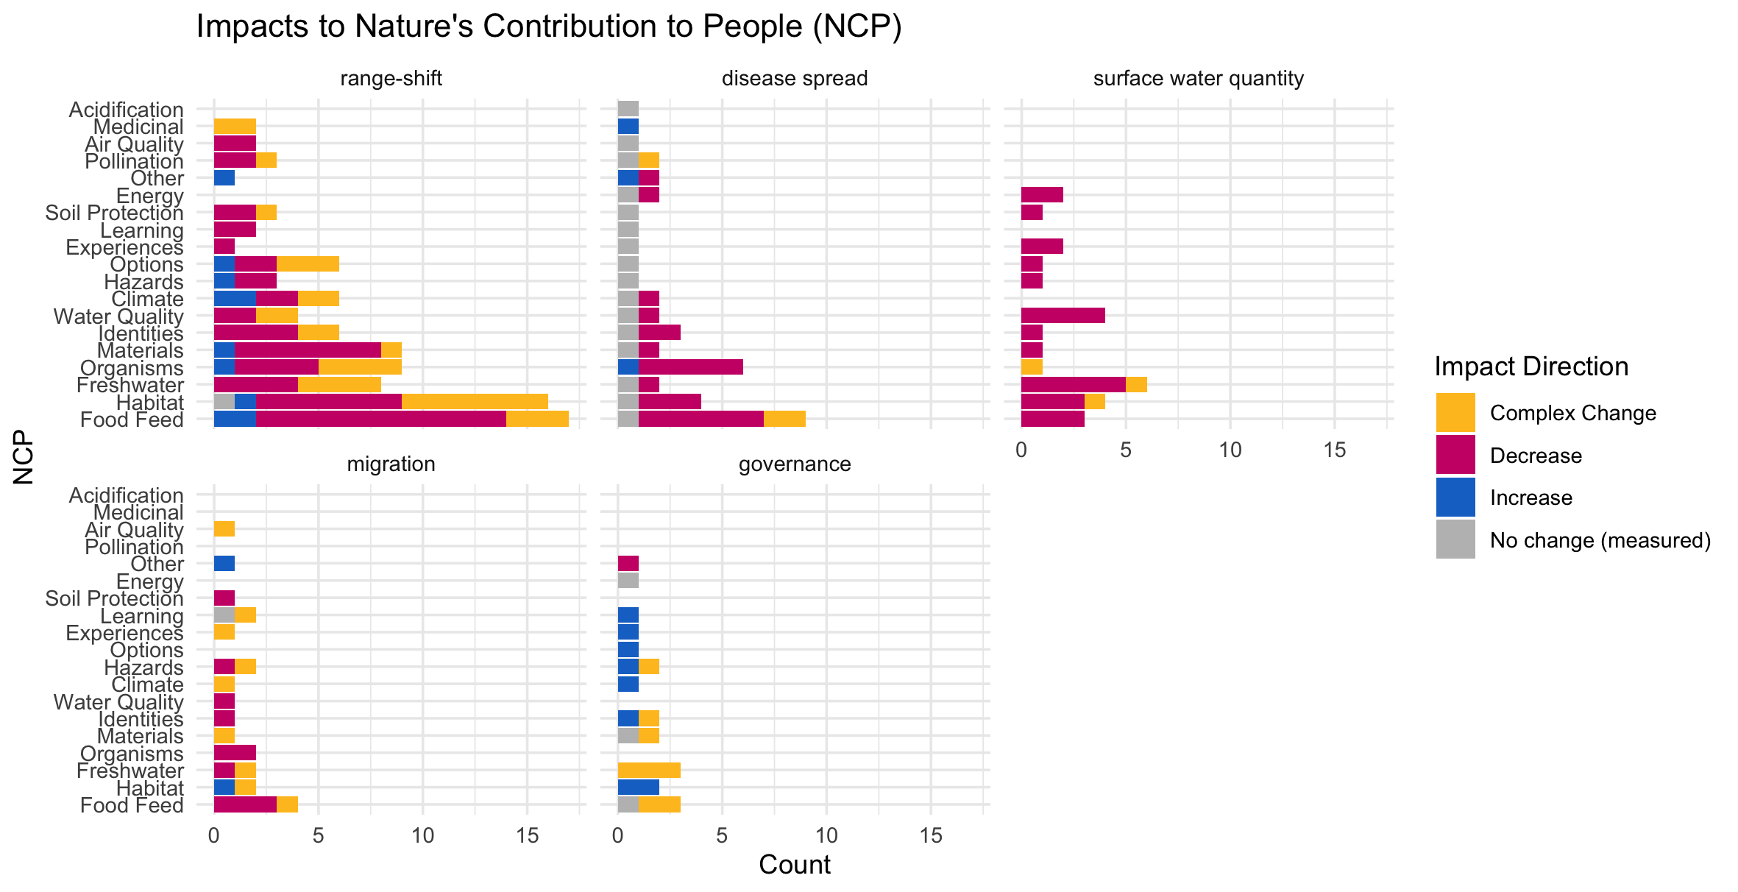

Slide 29
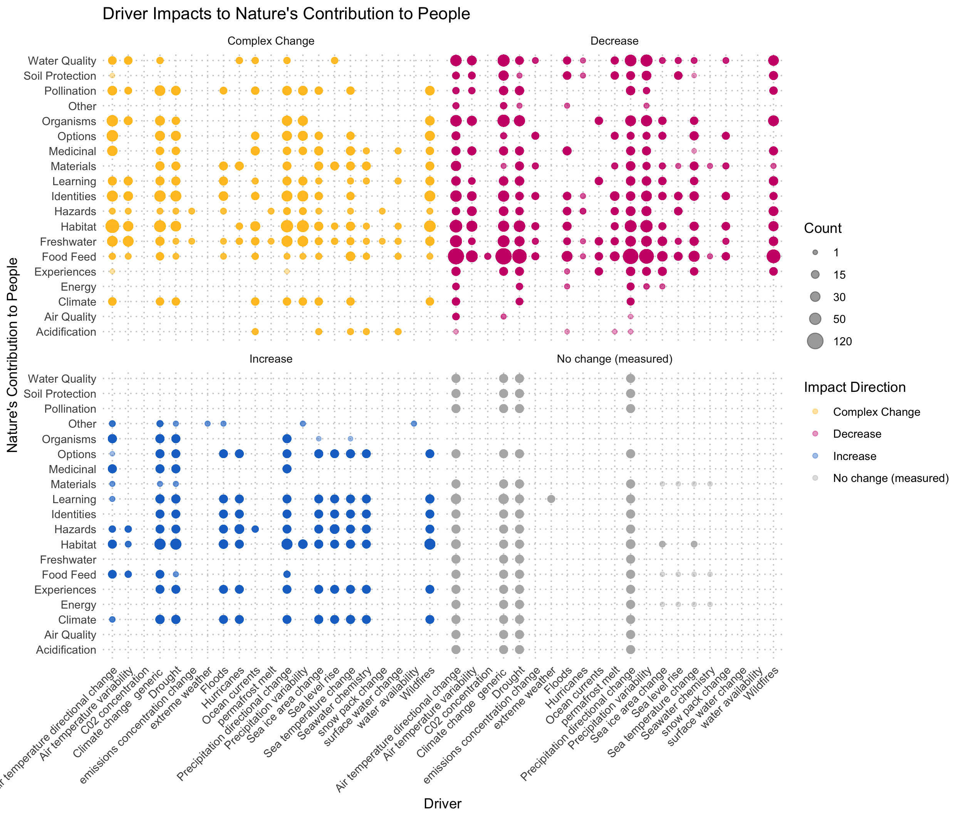

Slide 30
Should check the other
Cohesion Justice Other Relational Welfare
18 21 7 31 76
By far, the most studied element of human well-being in our study context was welfare (n = 76; ~50%), followed by relational (n=31; 20%), justice (n=21; 14%), and cohesion (n=18) dimensions of well-being (with 7 data points for other dimesions, including xxxxx).
The majority of evidence indicated decreasing welfare (86.8%) and relational well-being (64.5%) associated with climate-driven alteration of flow.
While fewer studies consider cohesion and justice, changes in justice were predominantly complex (47.6%) or decreasing (43%), with less than 10% increases, whereas the evidence for effects on cohesion were more mixed: 39% complex or decreasing, with 16.7 increasing and 5.6% with no change.
hwb n prop
<chr> <int> <dbl>
1 Cohesion 18 0.118
2 Justice 21 0.137
3 Other 7 0.0458
4 Relational 31 0.203
5 Welfare 76 0.497

Slide 31
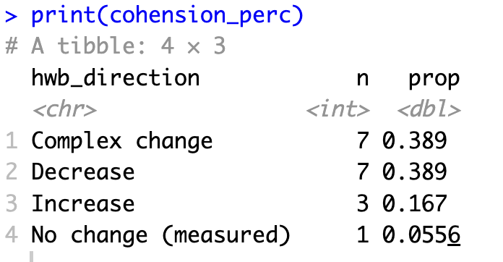
HWB trends: Cohesion

Slide 32
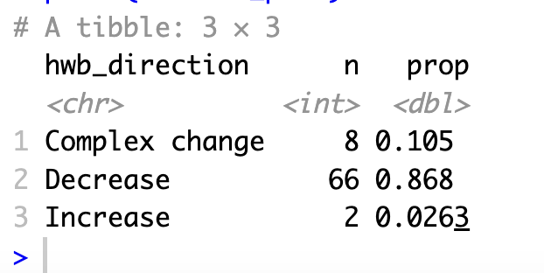
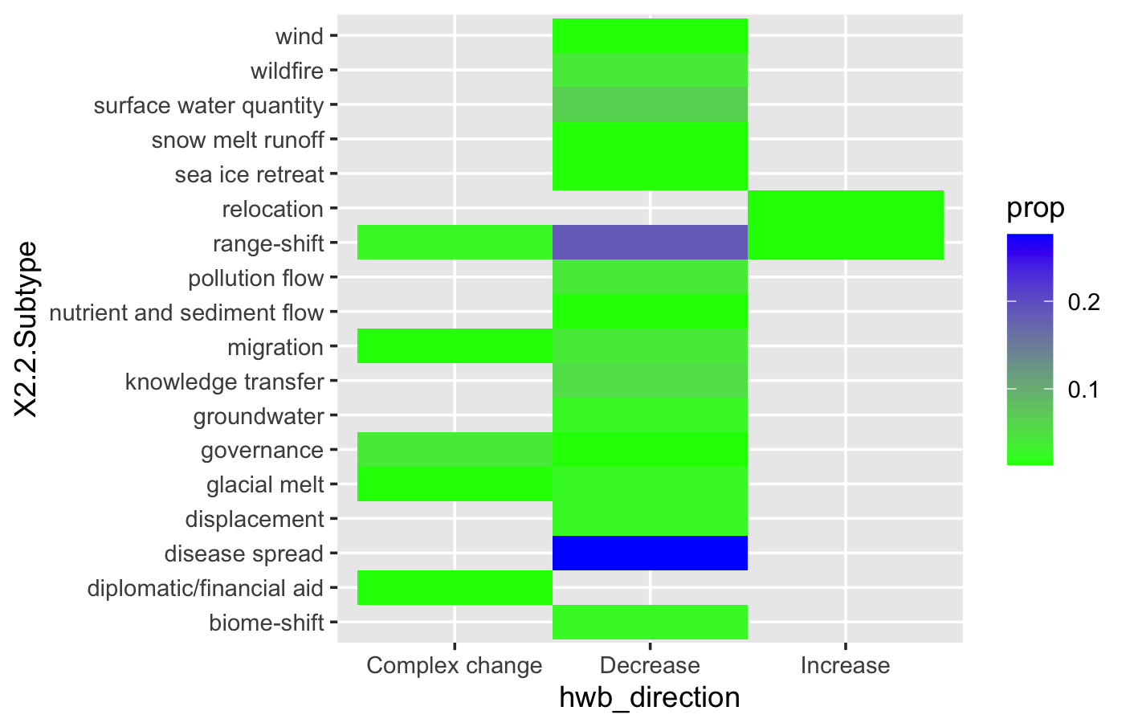
HWB trends: Welfare

Slide 33
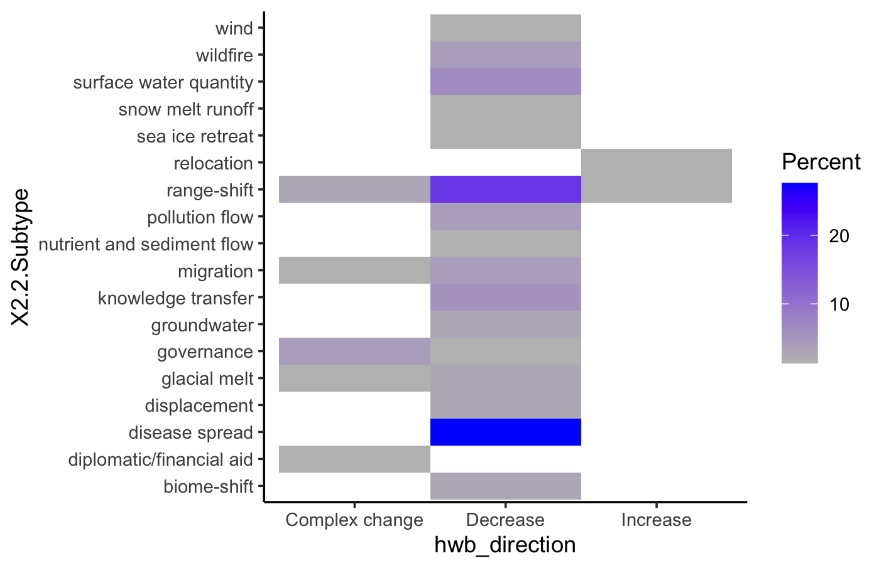

Slide 34
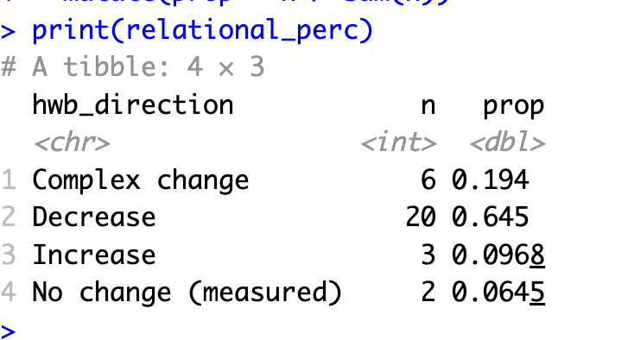
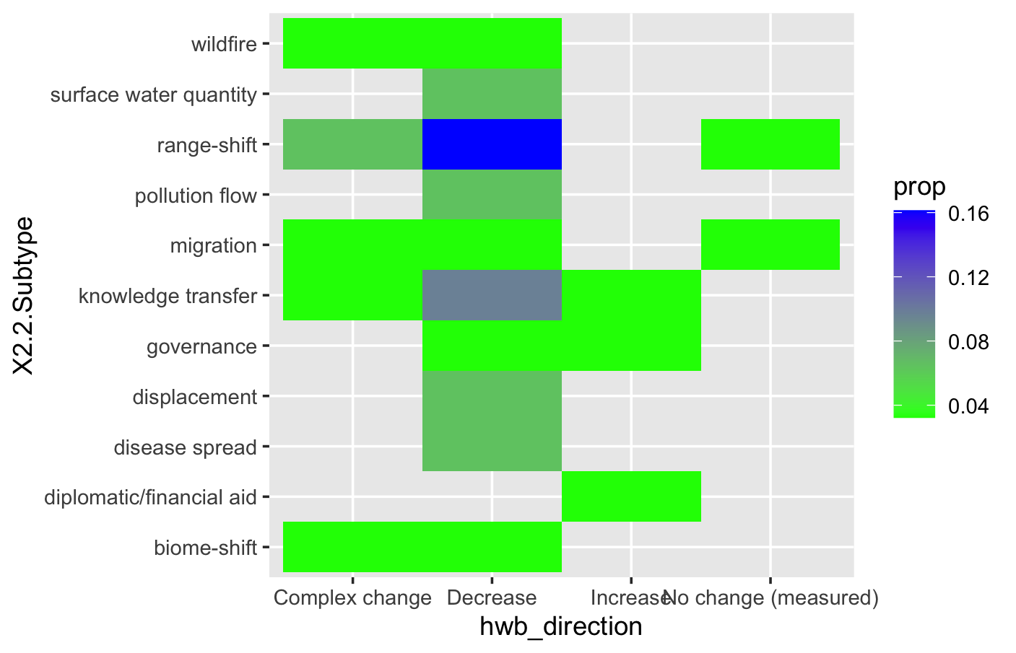
HWB trends: Relational

Slide 35
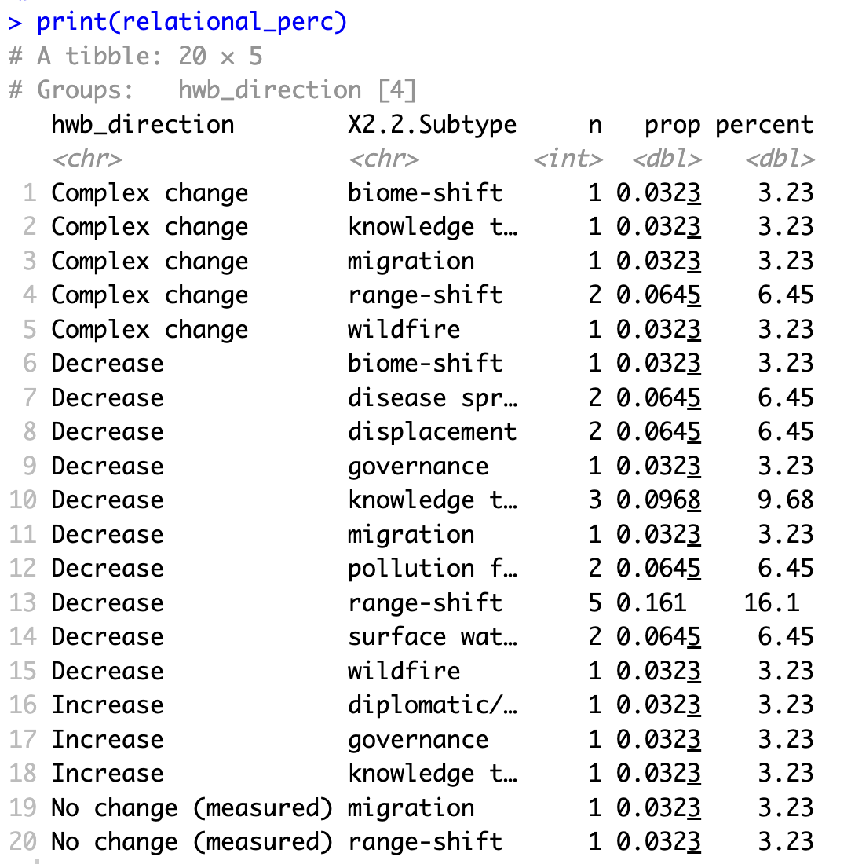

HWB trends: Relational

Slide 36
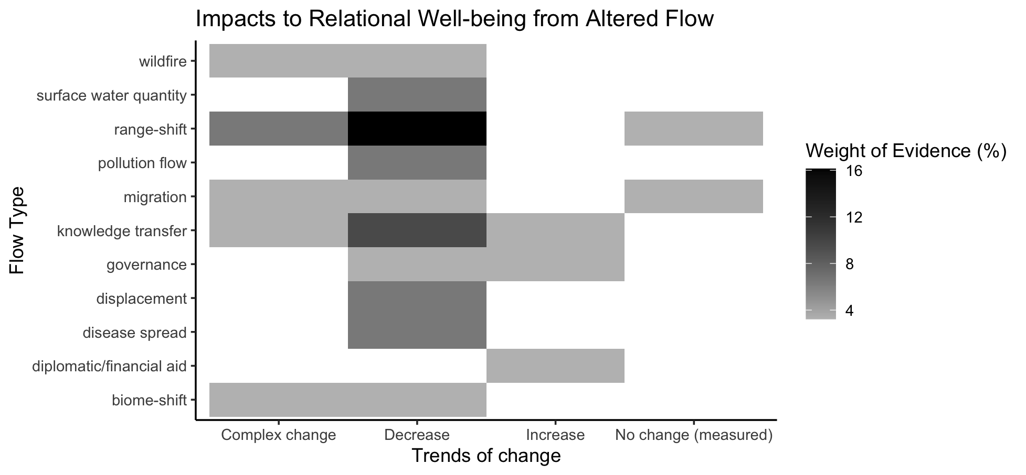
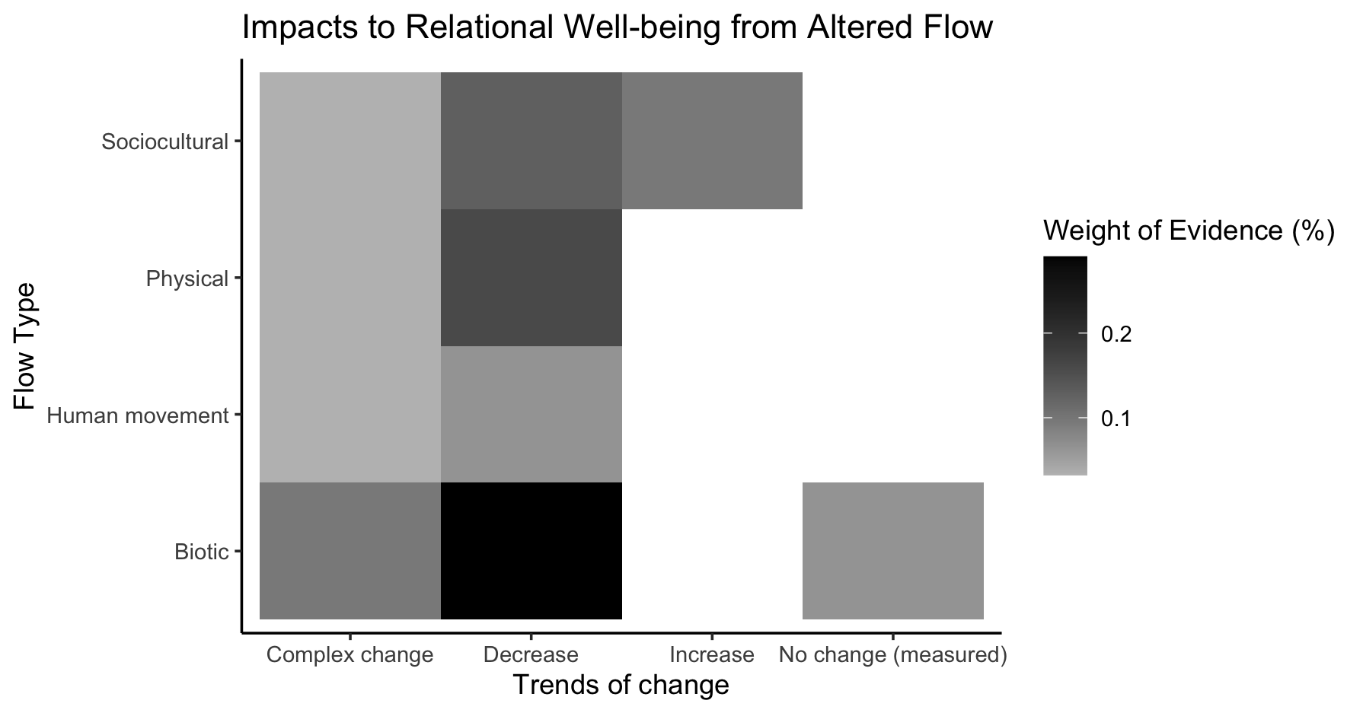
Relational

Slide 37
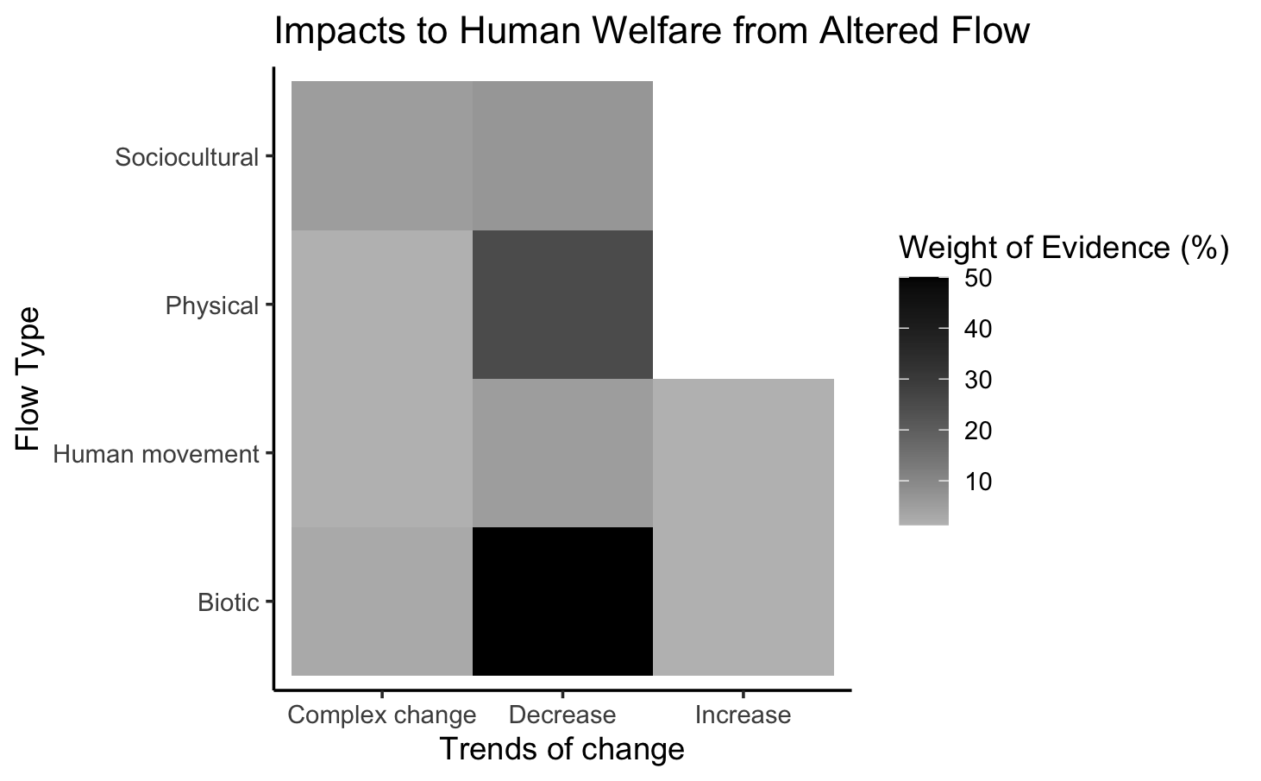
Welfare

Slide 38
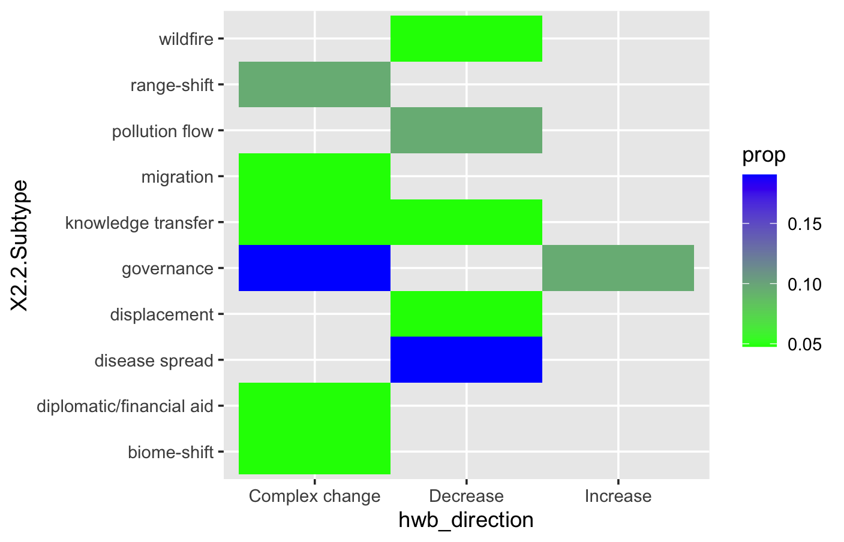
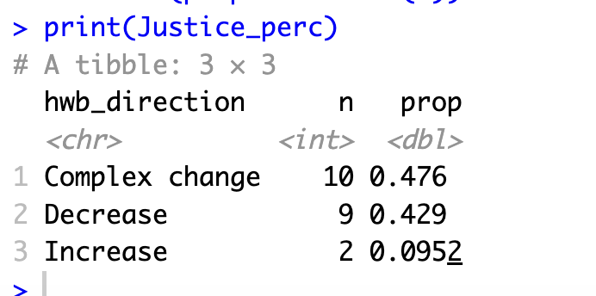
HWB trends: Justice

Slide 39
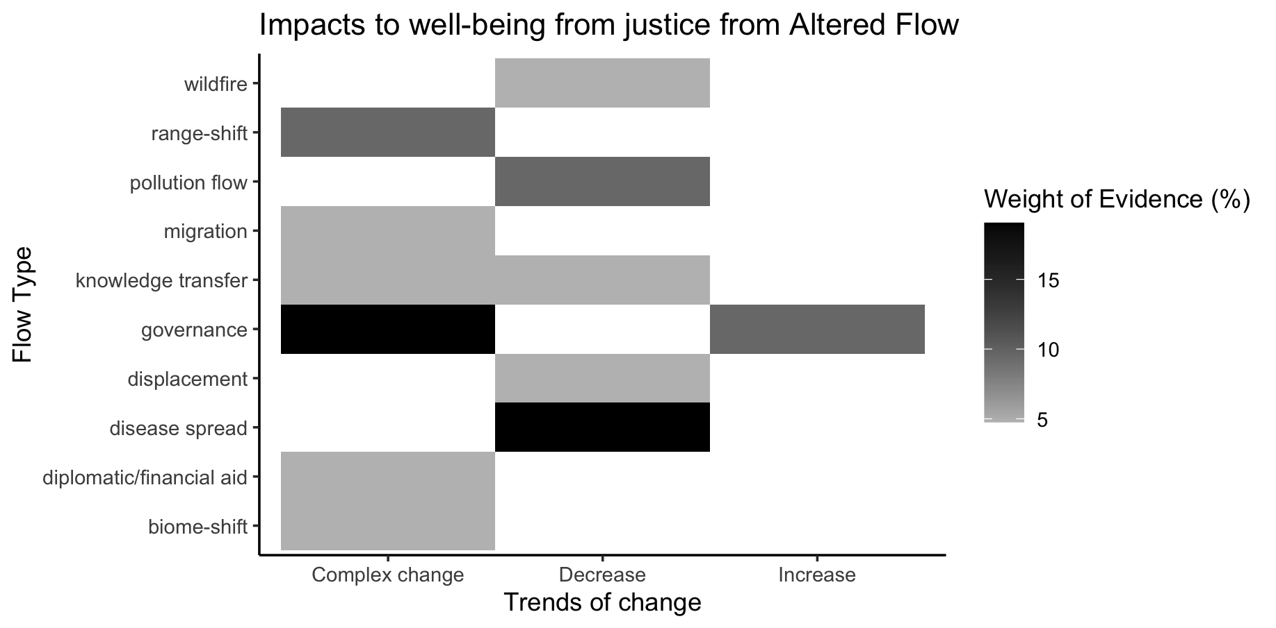

Slide 40
Other hwb in otherhwb.txt

Slide 41
Table 1. Summary of evidence for changes in dimensions of human well-being and knowledge gaps.
Trend type | Well- Established Decreasing | Established Decreasing | Well- Established Complex Changes and Decreasing | Established Complex Changes and Decreasing | Mixed Evidence | Insufficient Evidence
Category | Welfare Relational well-being
n

Slide 42
OLDER:

Slide 44
At least 5 entries – top – to get stats on % of entries or papers on these:

Slide 45
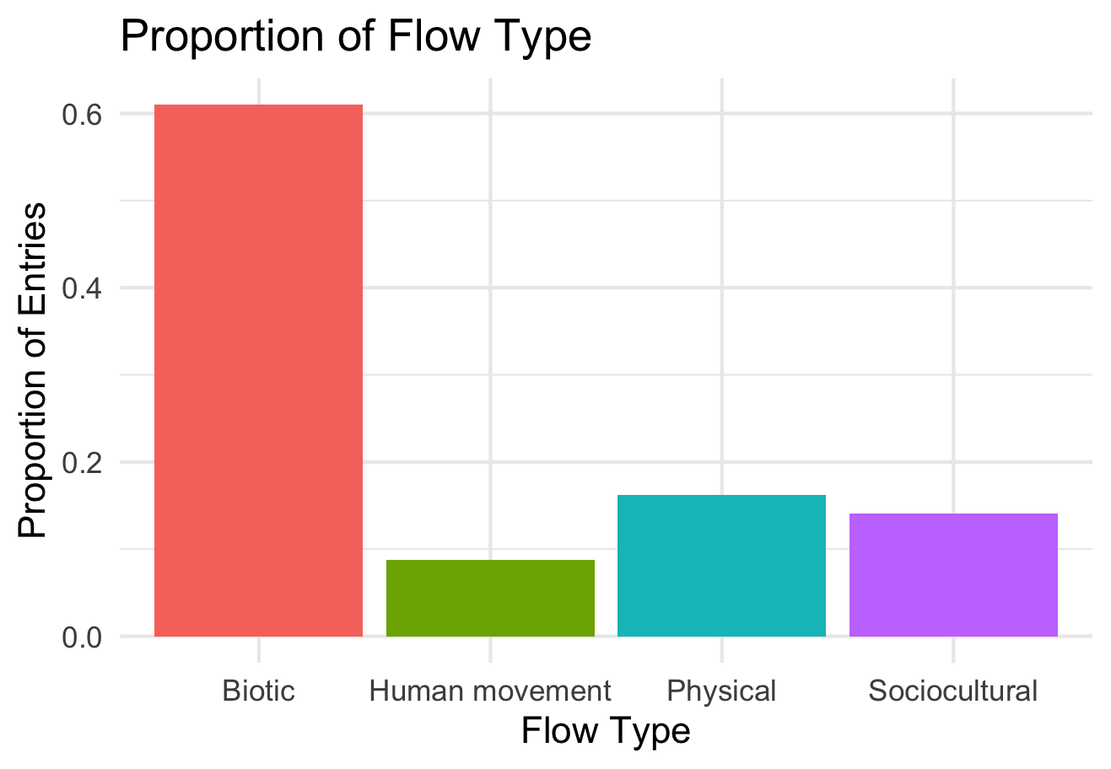

Slide 46
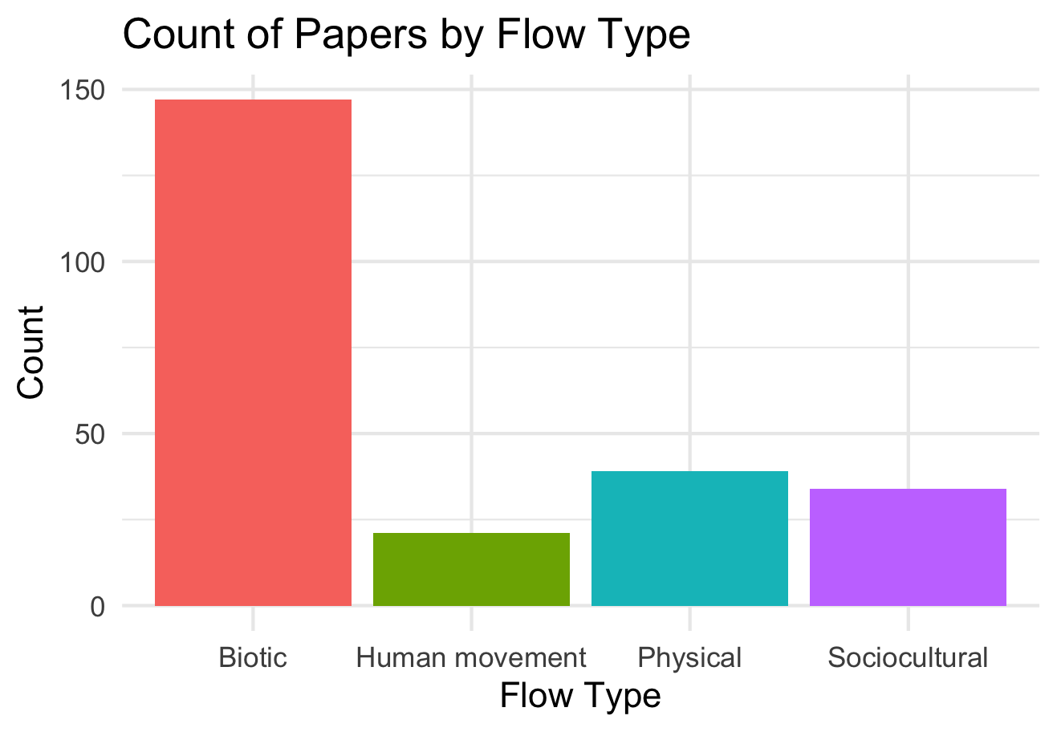

Slide 47
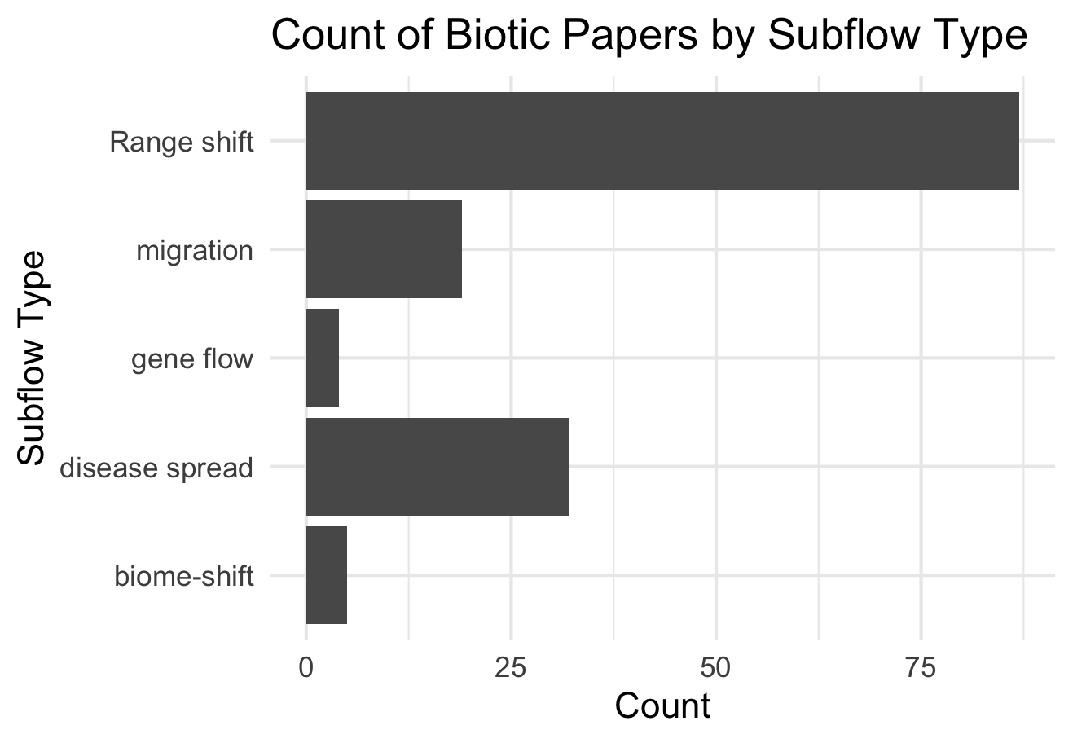

Slide 48
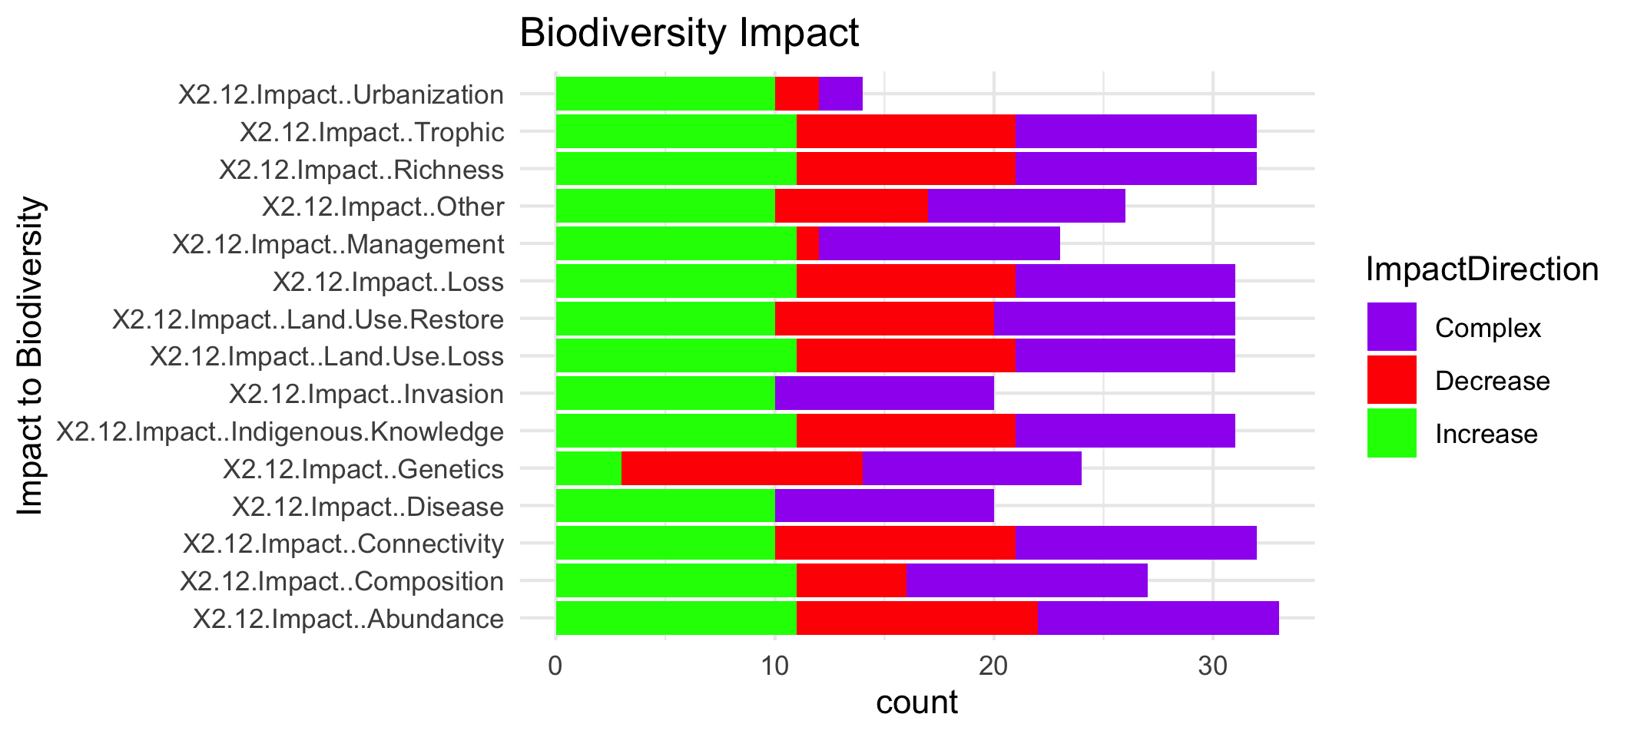

Slide 50
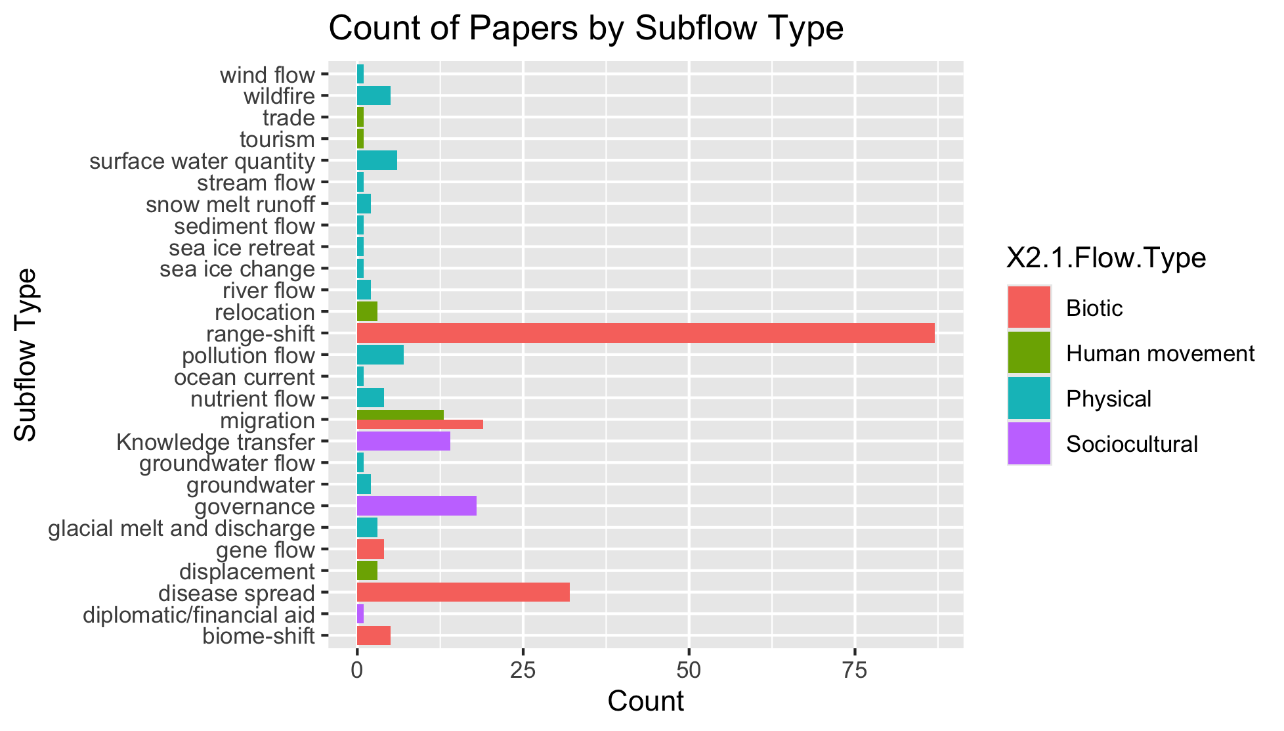
To group physical flow papers

Slide 51
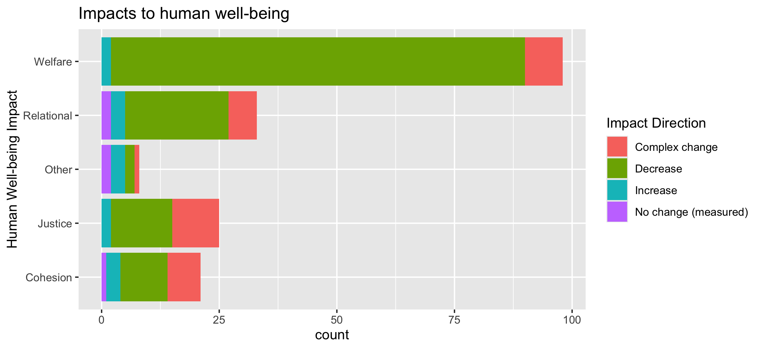
To align direction colors with final color pallet

Slide 52
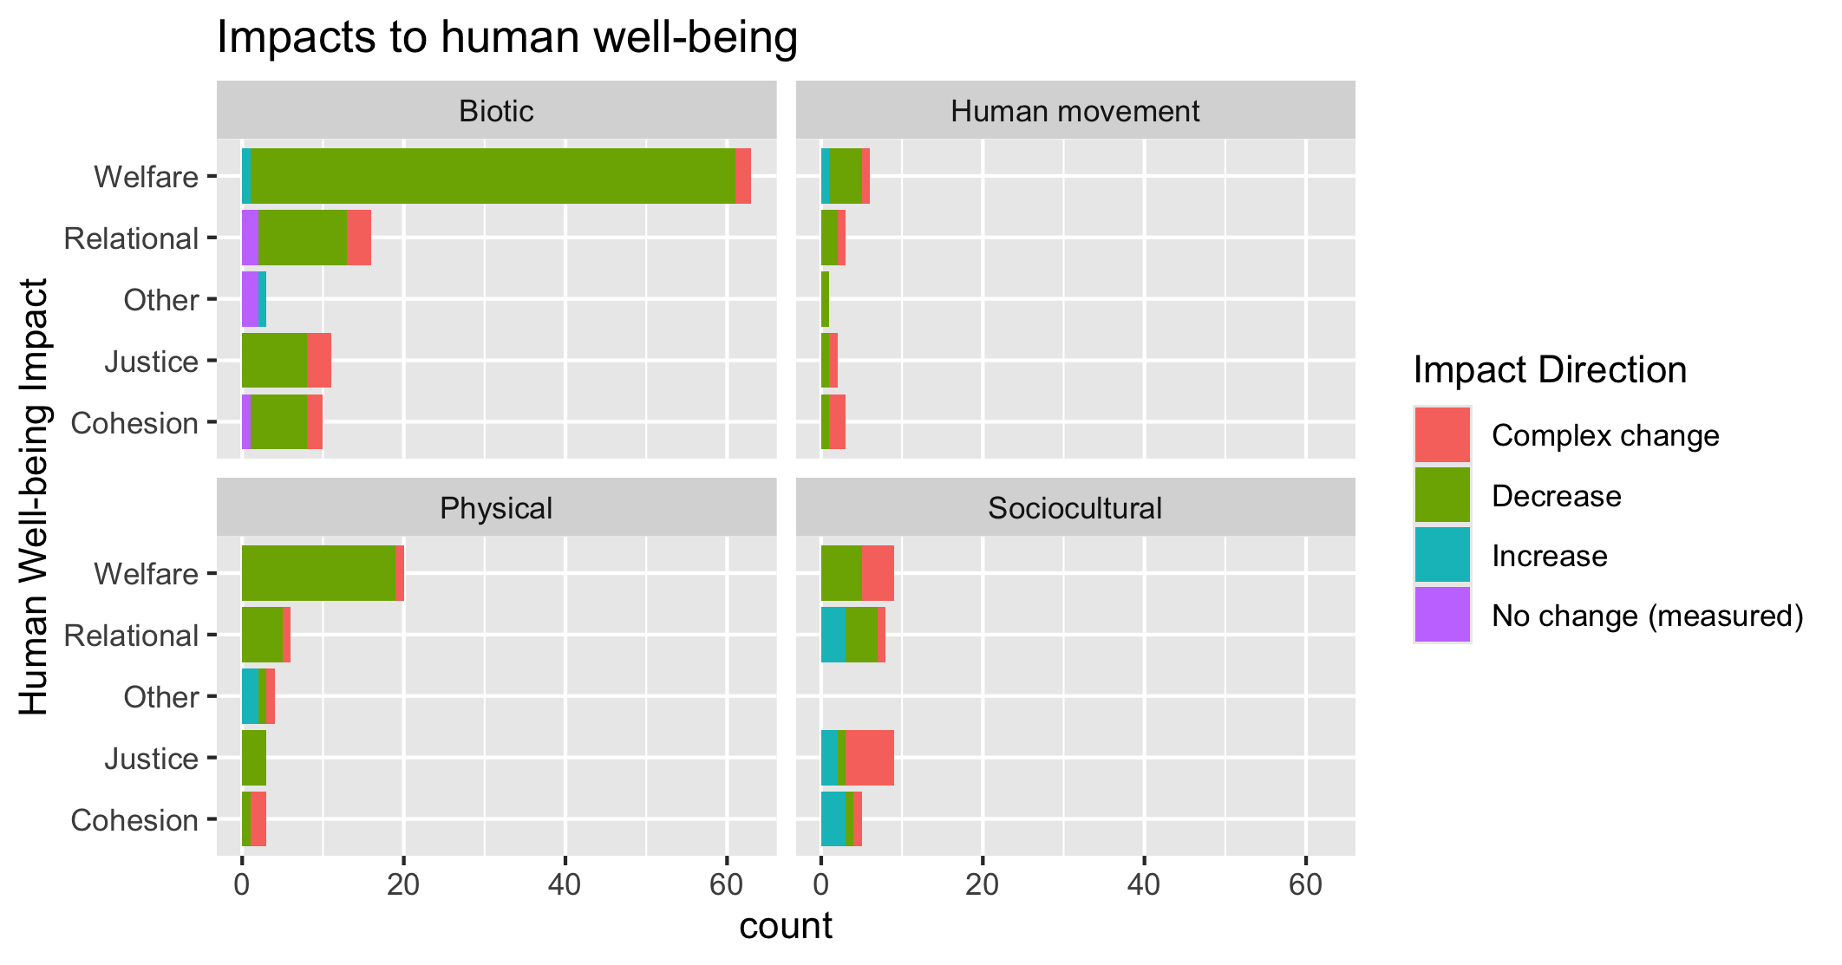
To align direction colors with final color pallet

Slide 53
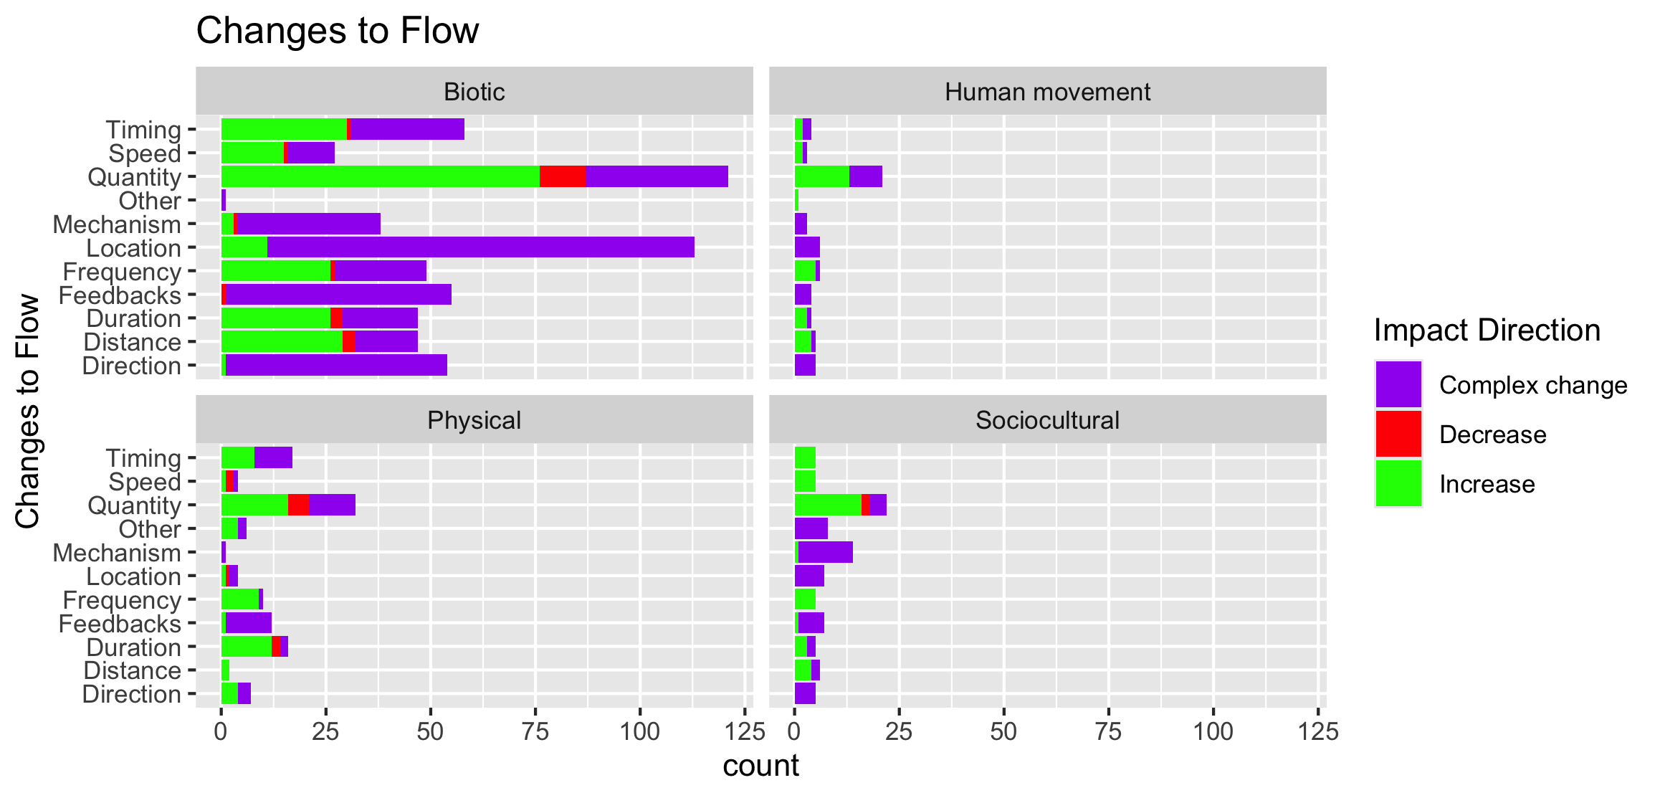

Slide 54
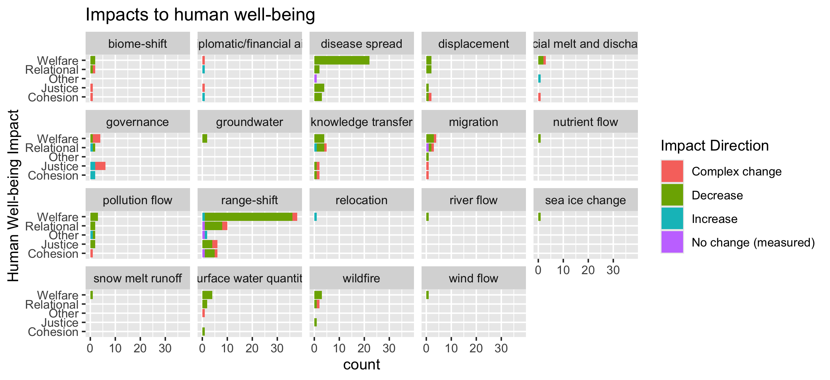
To group physical flow papers

Slide 55
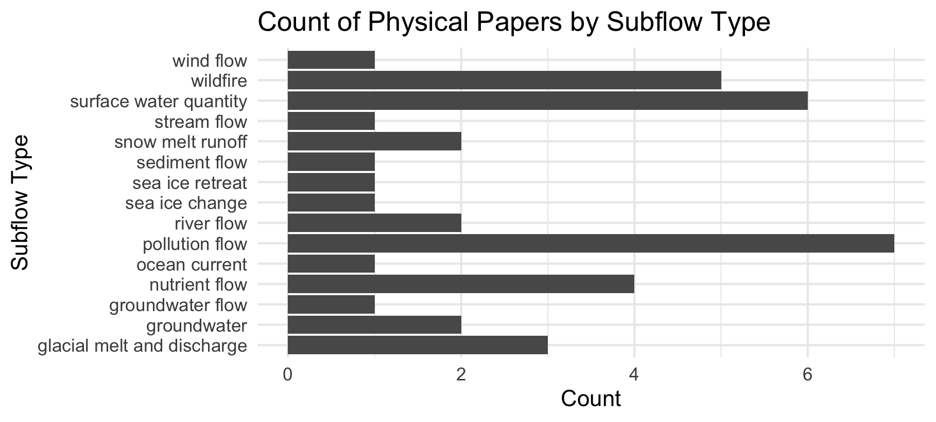

Slide 56
Feb 23 2025

Slide 57
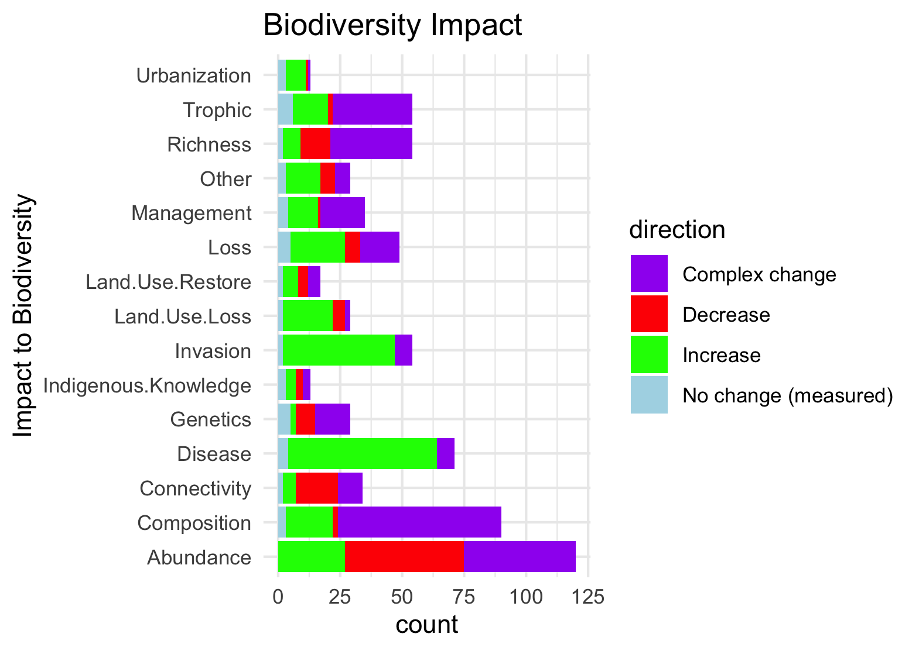
Needs to be grouped by what is good and what is bad to see increase in:

Slide 58
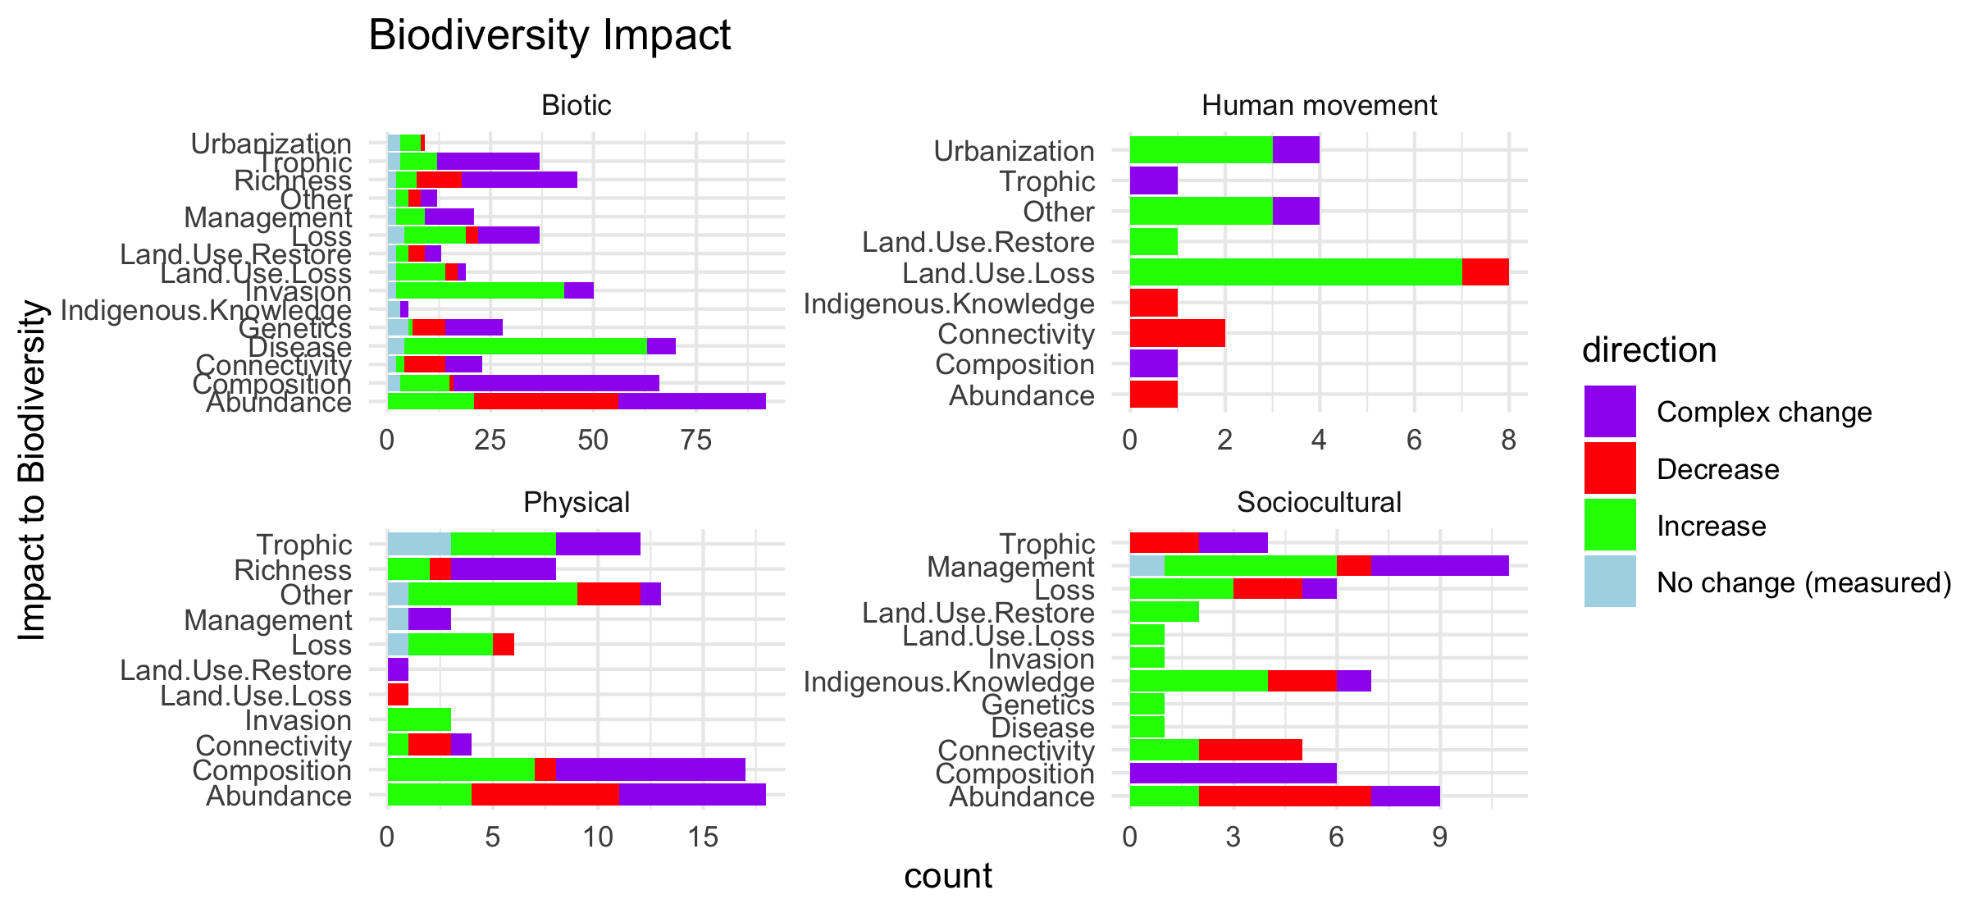
Scale free on the facet (diff x axis)

Slide 59

Scale fixed on the facet (same x axis)

Slide 60


Slide 61

Colleen: see note isn the code – we could group spme of the drivers (hurricaines, extreme weather, ands ome of the ice ones). This still doesnt take into account if changes arw good or bad though and might just be too busy.

Slide 62

#not that informative because so many more of the papers are biotic

Slide 63
NCPs

Slide 64

Fix labels

Slide 65
Do by flow type

Slide 66
Fix labels

Slide 67


Slide 68

Too many drivers

Slide 69


Slide 70
HWB

Slide 71
Connections – how does altered flow relate
Driver~ altered flow (by flow, and subflow – grouped out by flow
Altered flow~ impact (for each category)

